Slide 1

The Creative Commons Attribution Card Game is created by Rachel Scanlon and licensed under a CC BY 4.0 licence.
https://creativecommons.org/licenses/by/4.0/

Slide 2


Creative Commons
Attribution Card Game
CC BY 4.0

Slide 3
Creative Commons
Attribution Card Game
Four elements of an ideal
Creative Commons attribution:
    Title
    Author
    Source
    Licence
Hint card

Slide 4
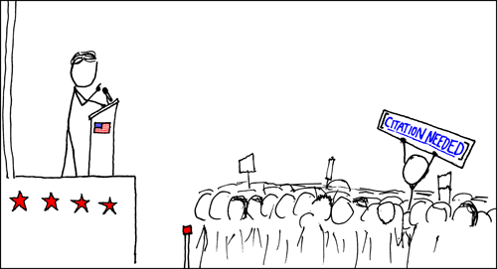
Title:
Wikipedian Protestor

Slide 5
Author:
Randall Munroe

Slide 6
Licence:
CC BY NC 2.5

Slide 7
Source:
https://xkcd.com/285/

Slide 8
Publisher:
XKCD

Slide 9
Year:
Unknown

Slide 10
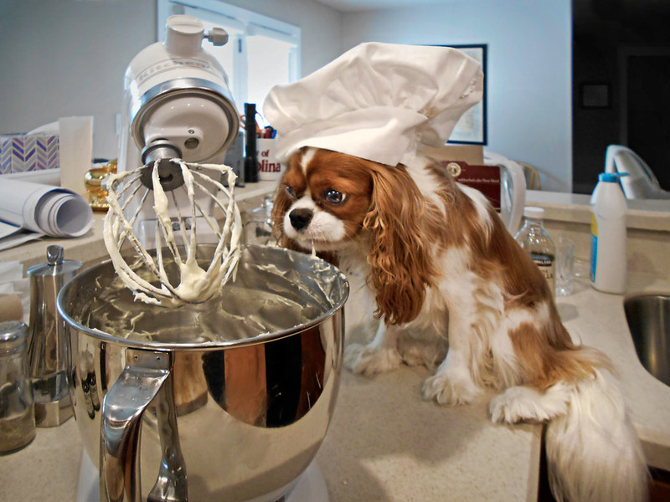
Title:
Maieze and the cake

Slide 11
Author:
Ken Dodd

Slide 12
Licence:
CC BY NC ND

Slide 13
Source:
https://www.flickr.com/
photos/doddsjzi/
23996401756/

Slide 14
Publisher:
Flickr

Slide 15
Year:
2015

Slide 16
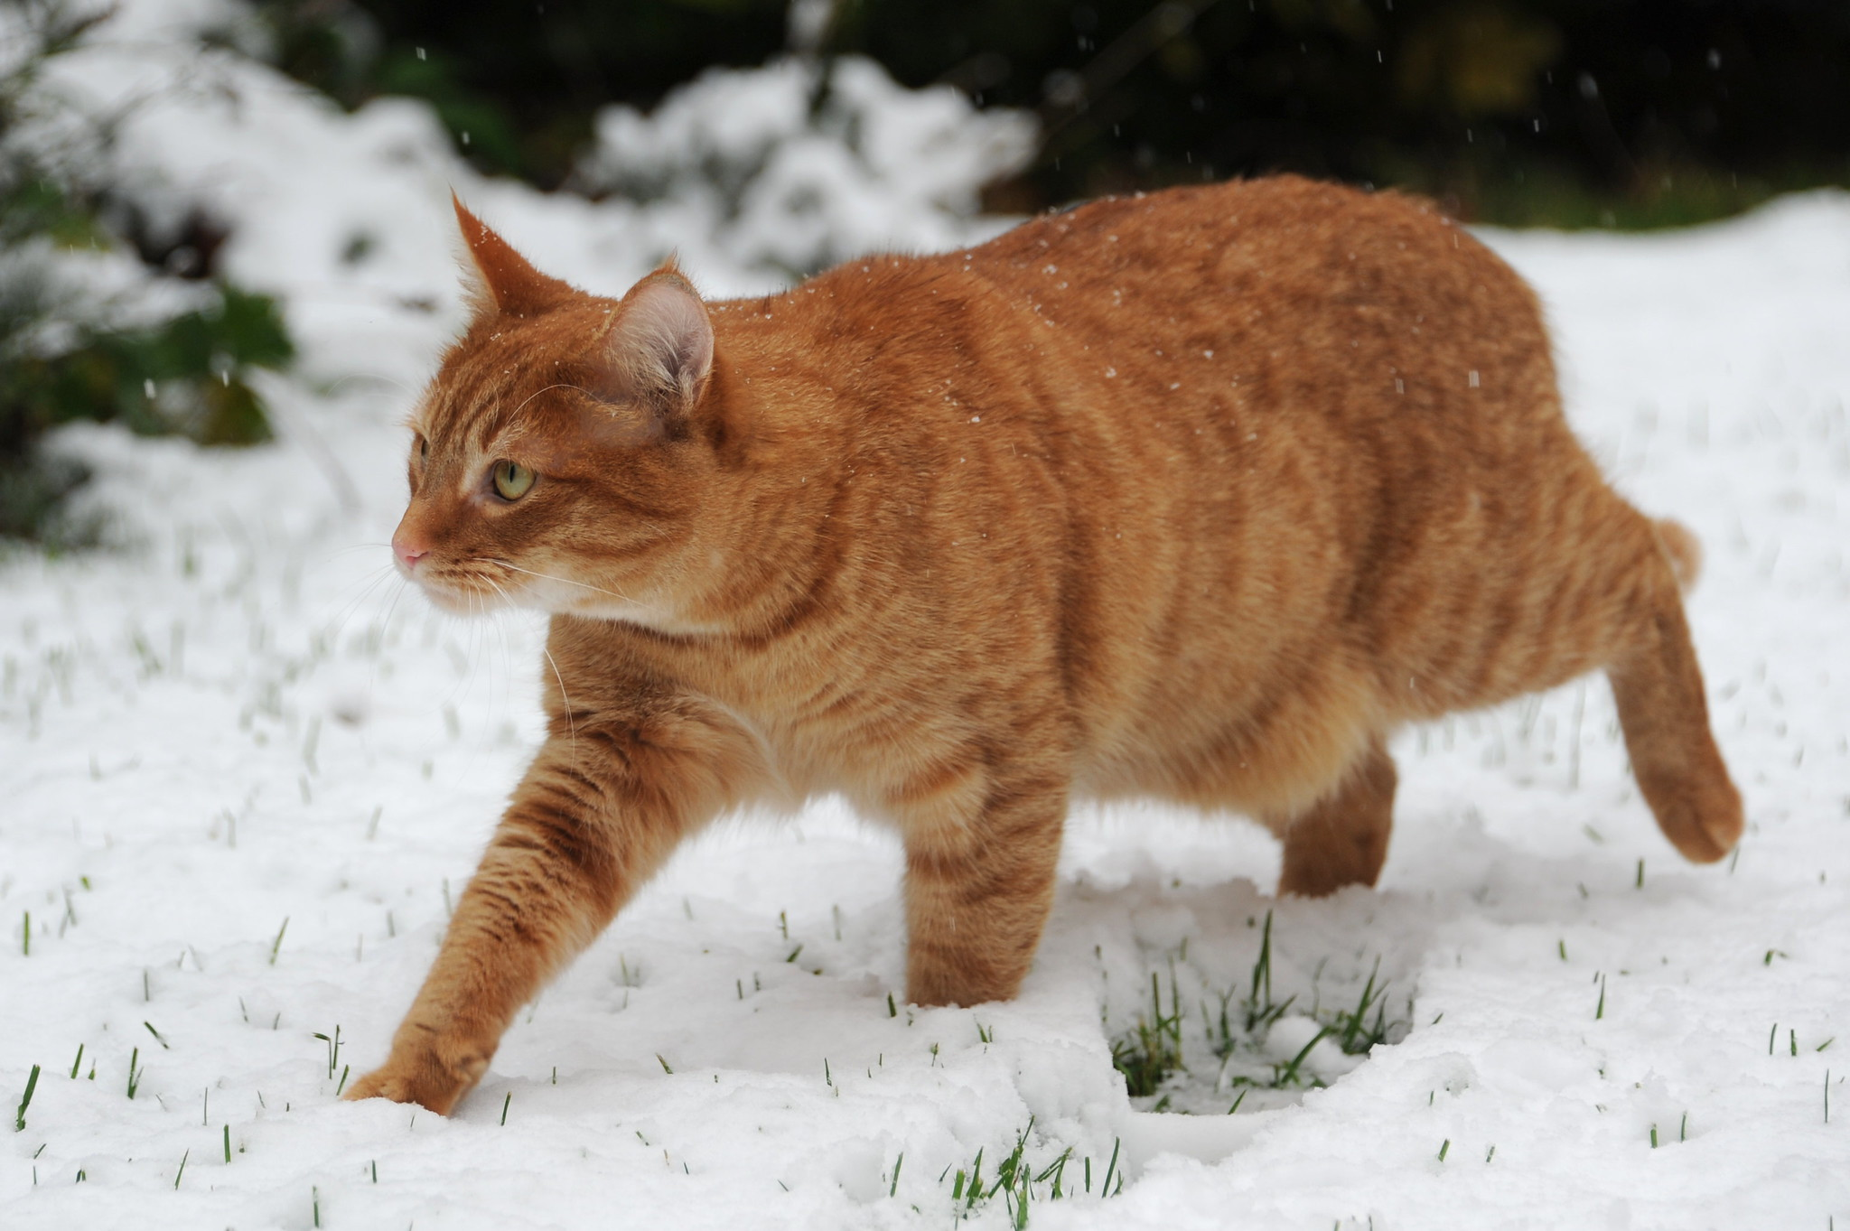
Title:
Snow Cat II

Slide 17
Author:
Suzanne Hamilton

Slide 18
Licence:
CC BY NC ND 2.0

Slide 19
Source:
https://www.flickr.com/
photos/suzannehamilton/25820663948/

Slide 20
Publisher:
Flickr

Slide 21
Year:
2017

Slide 22
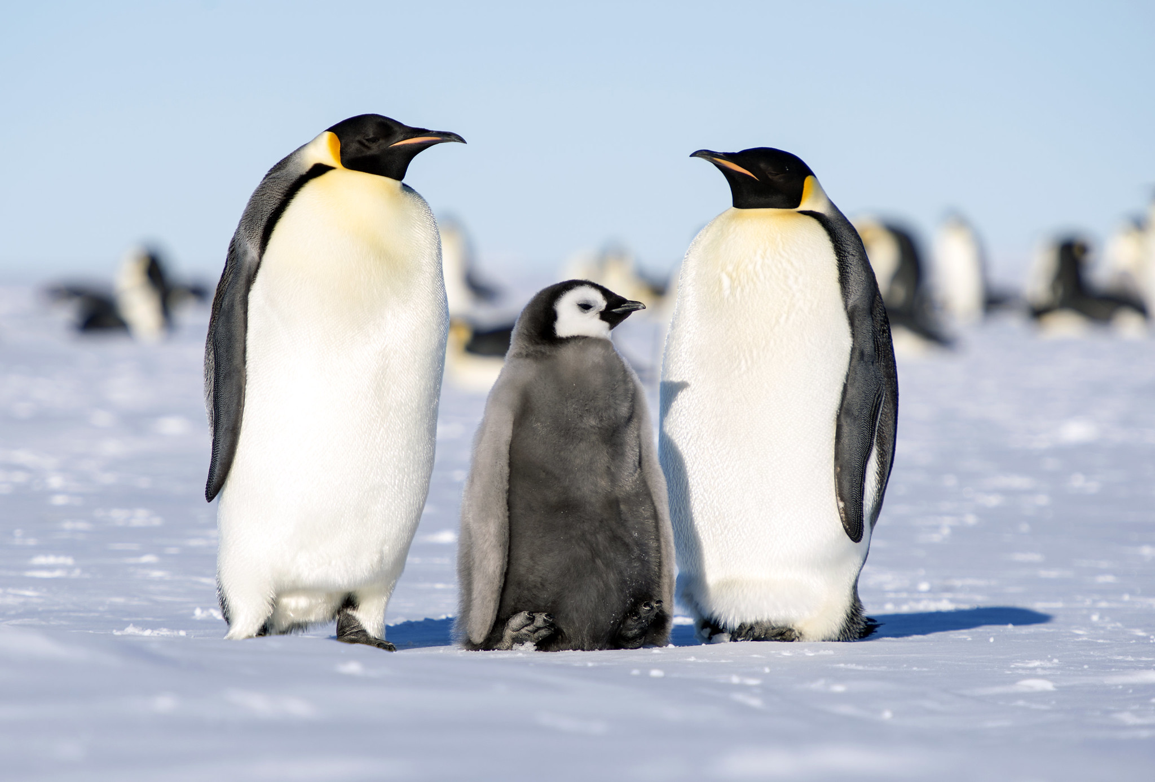
Title:
Emperor Penguins

Slide 23
Author:
Christopher Michel

Slide 24
Licence:
CC BY 2.0

Slide 25
Source:
https://www.flickr.com/
photos/cmichel67/
11278870305/

Slide 26
Publisher:
Flickr

Slide 27
Year:
2013

Slide 28
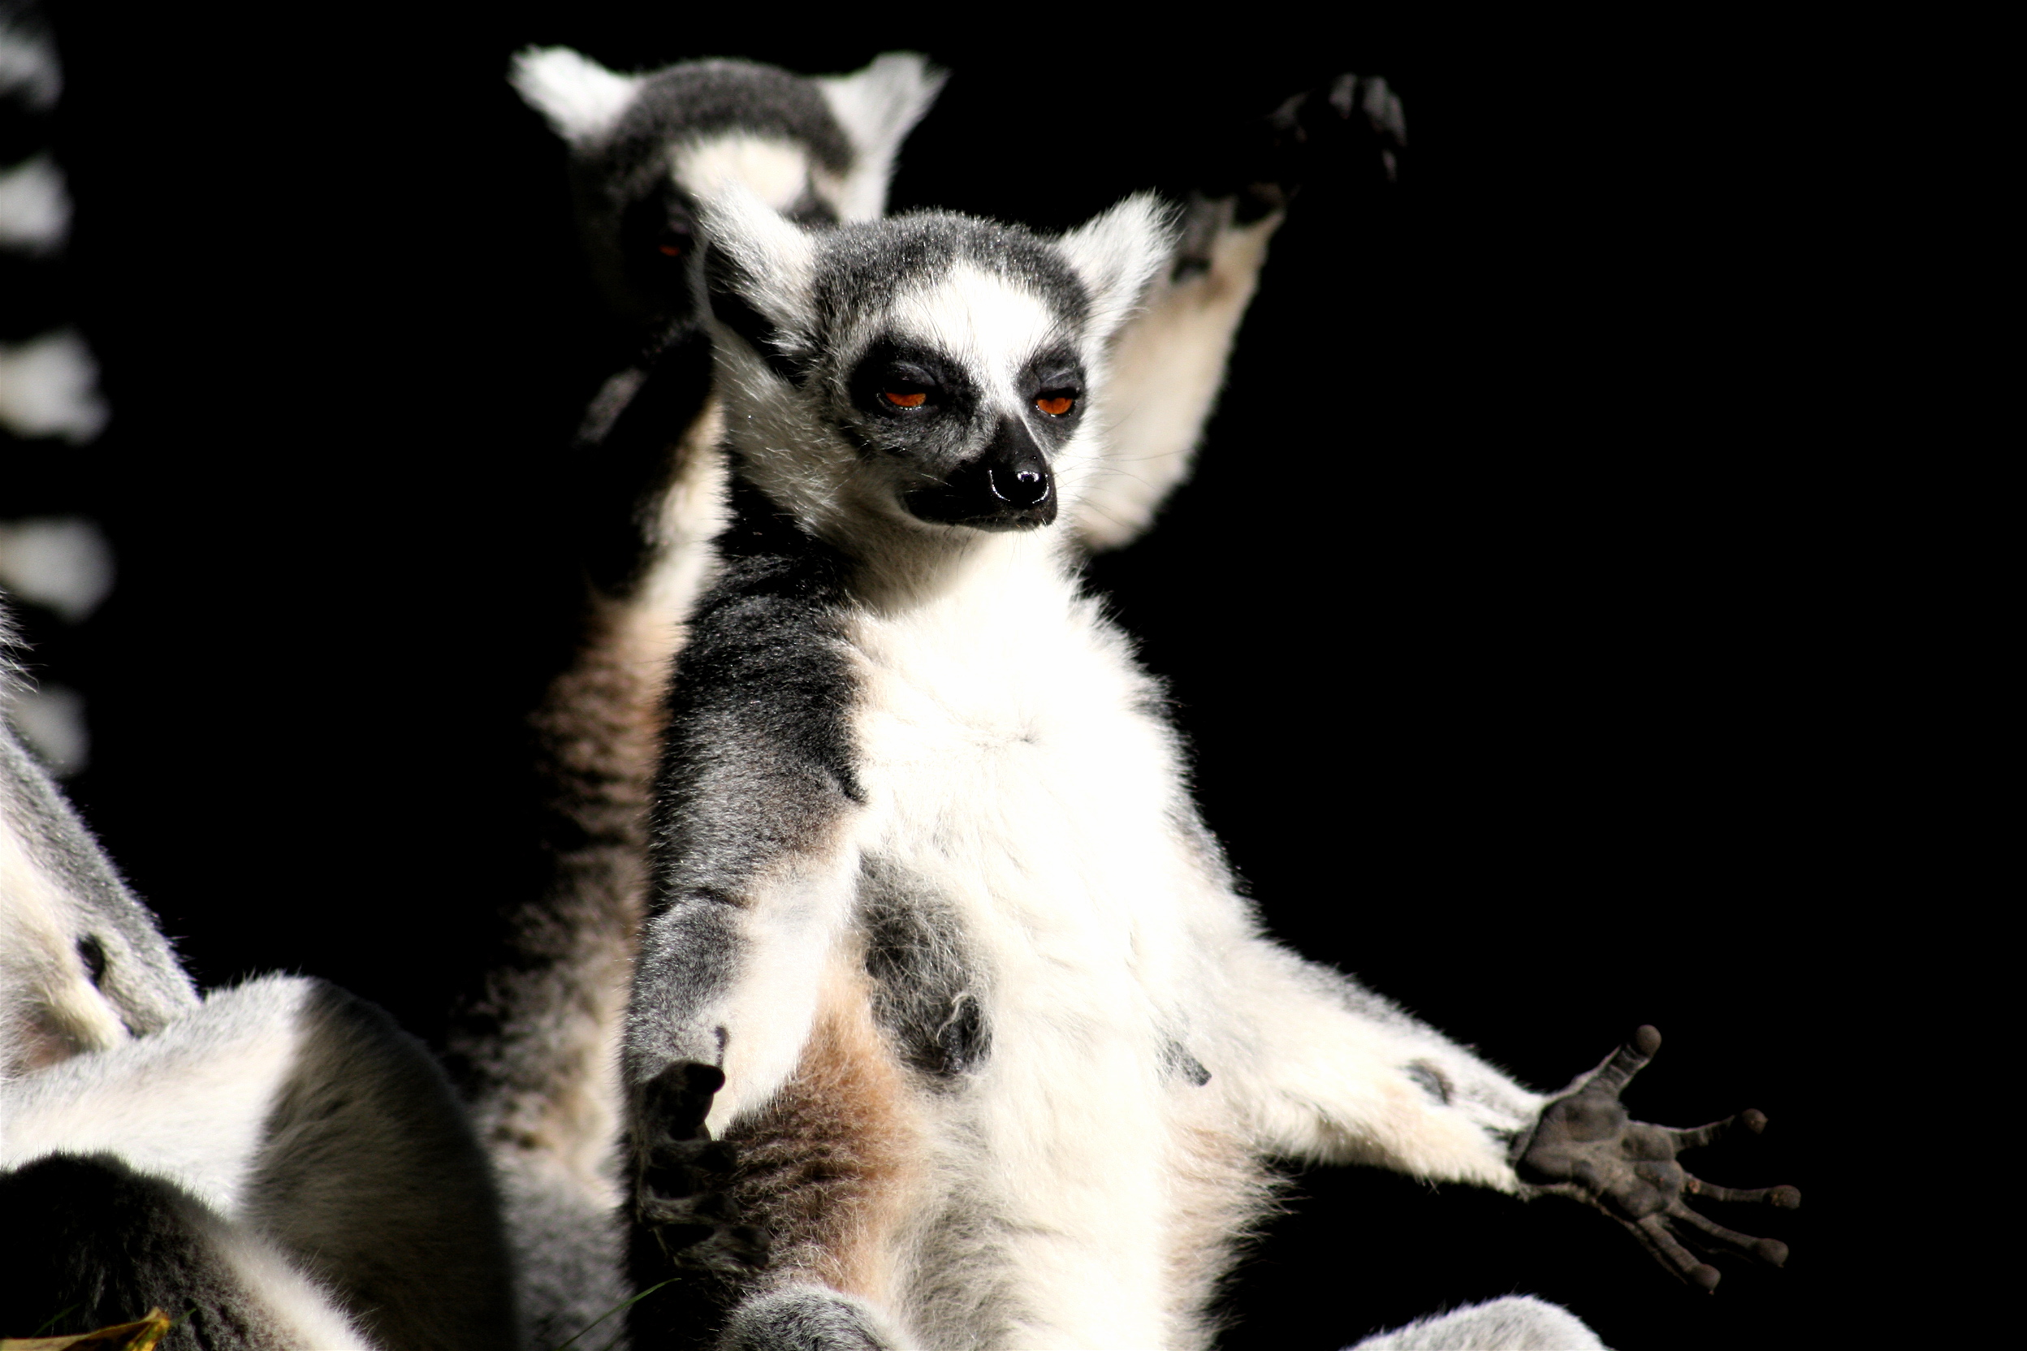
Title:
Hamburg: Hagenbeck - Lemuren

Slide 29
Author:
Hamburg Hagenbeck

Slide 30
Licence:
CC BY 2.0

Slide 31
Source:
https://www.flickr.com/
photos/c0t0d0s0/
52991741/

Slide 32
Publisher:
Flickr

Slide 33
Year:
2015

Slide 34
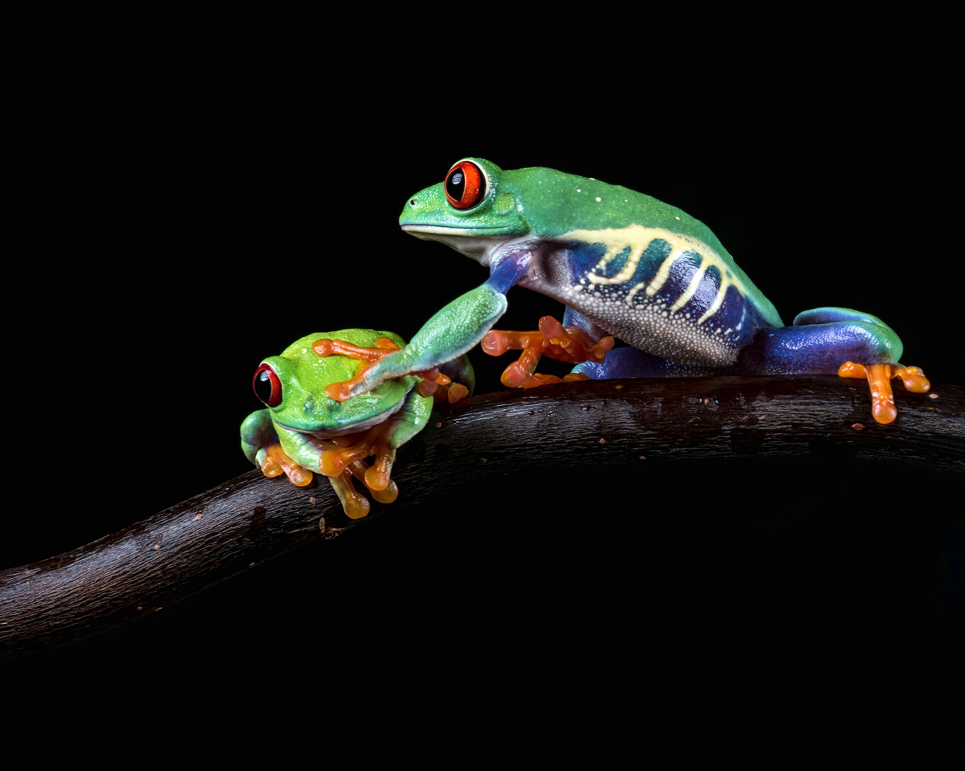
Title:
Gotcha!

Slide 35
Author:
hehaden

Slide 36
Licence:
CC BY NC 2.0

Slide 37
Source:
https://www.flickr.com/
photos/hellie55/
26103578432/

Slide 38
Publisher:
Flickr

Slide 39
Year:
2016

Slide 40
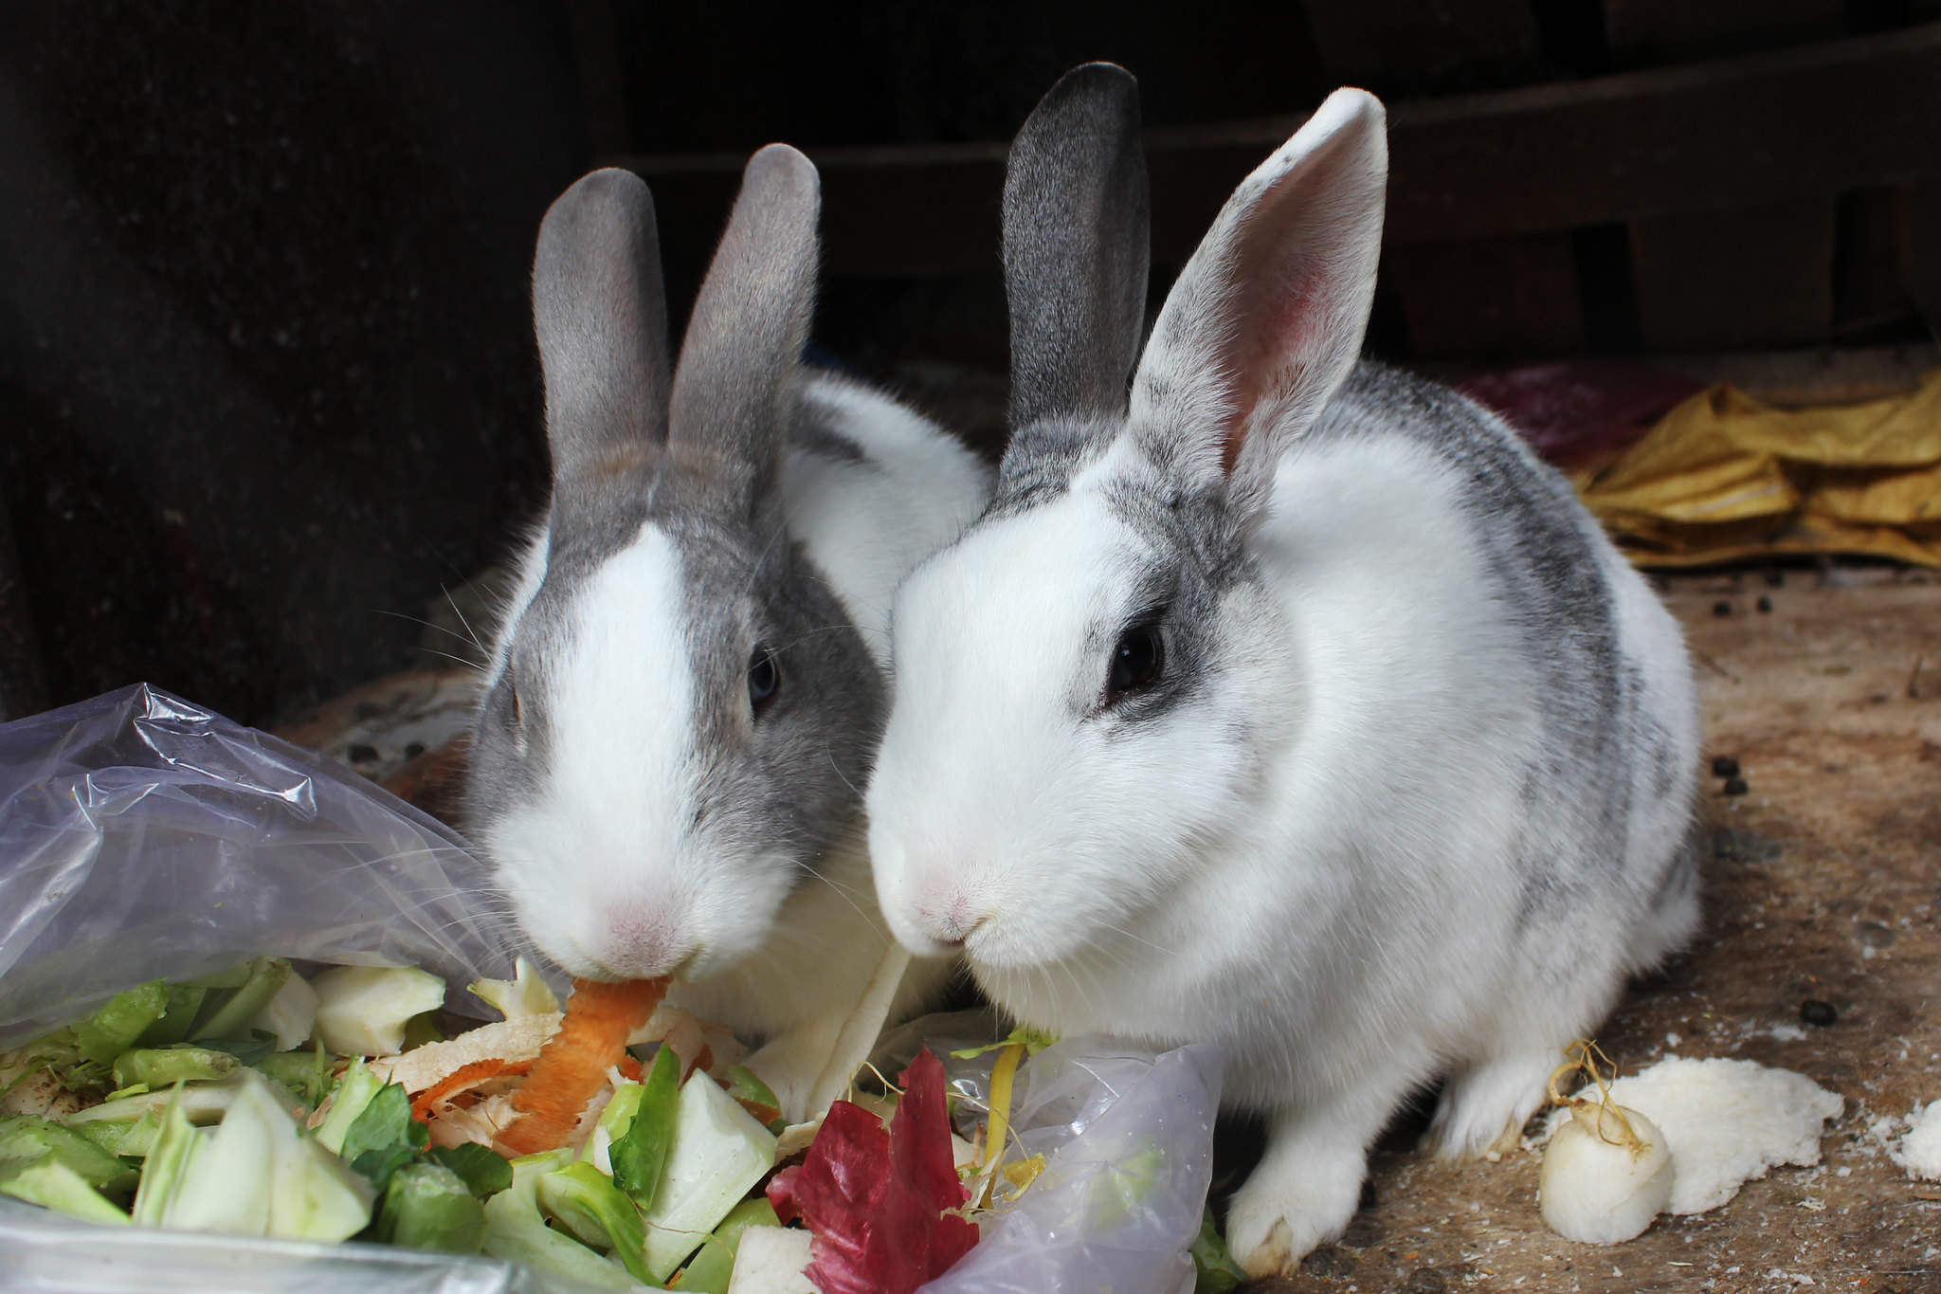
Title:
Together

Slide 41
Author:
Ritesh Man Tamrakar

Slide 42
Licence:
CC BY SA 2.0

Slide 43
Source:
https://www.flickr.com/photos/_rmt_/
39812716961

Slide 44
Publisher:
Flickr

Slide 45
Year:
2018

Slide 46
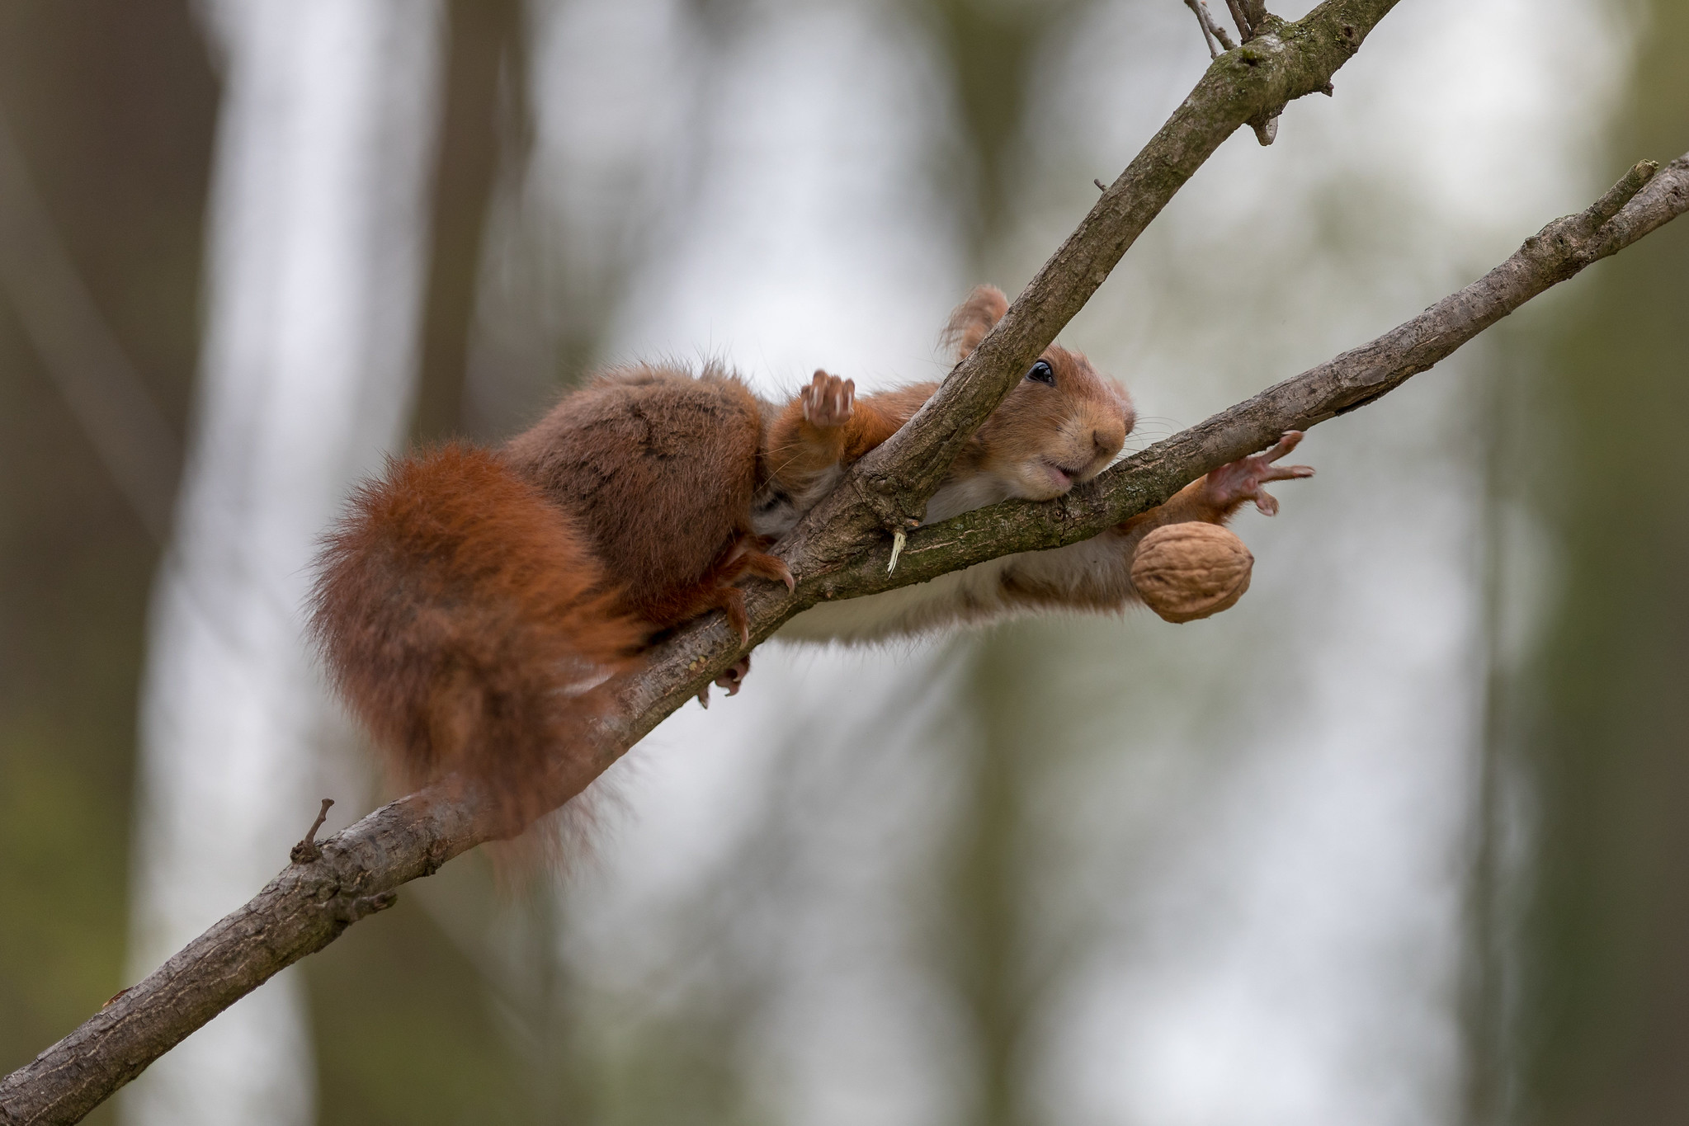
Title:
Nooooooooooooooo

Slide 47
Author:
Joachim Dobler

Slide 48
Licence:
CC BY SA 2.0

Slide 49
Source:
https://www.flickr.com/photos/142106242@
N05/47547242462/

Slide 50
Publisher:
Flickr

Slide 51
Year:
2019

Slide 52
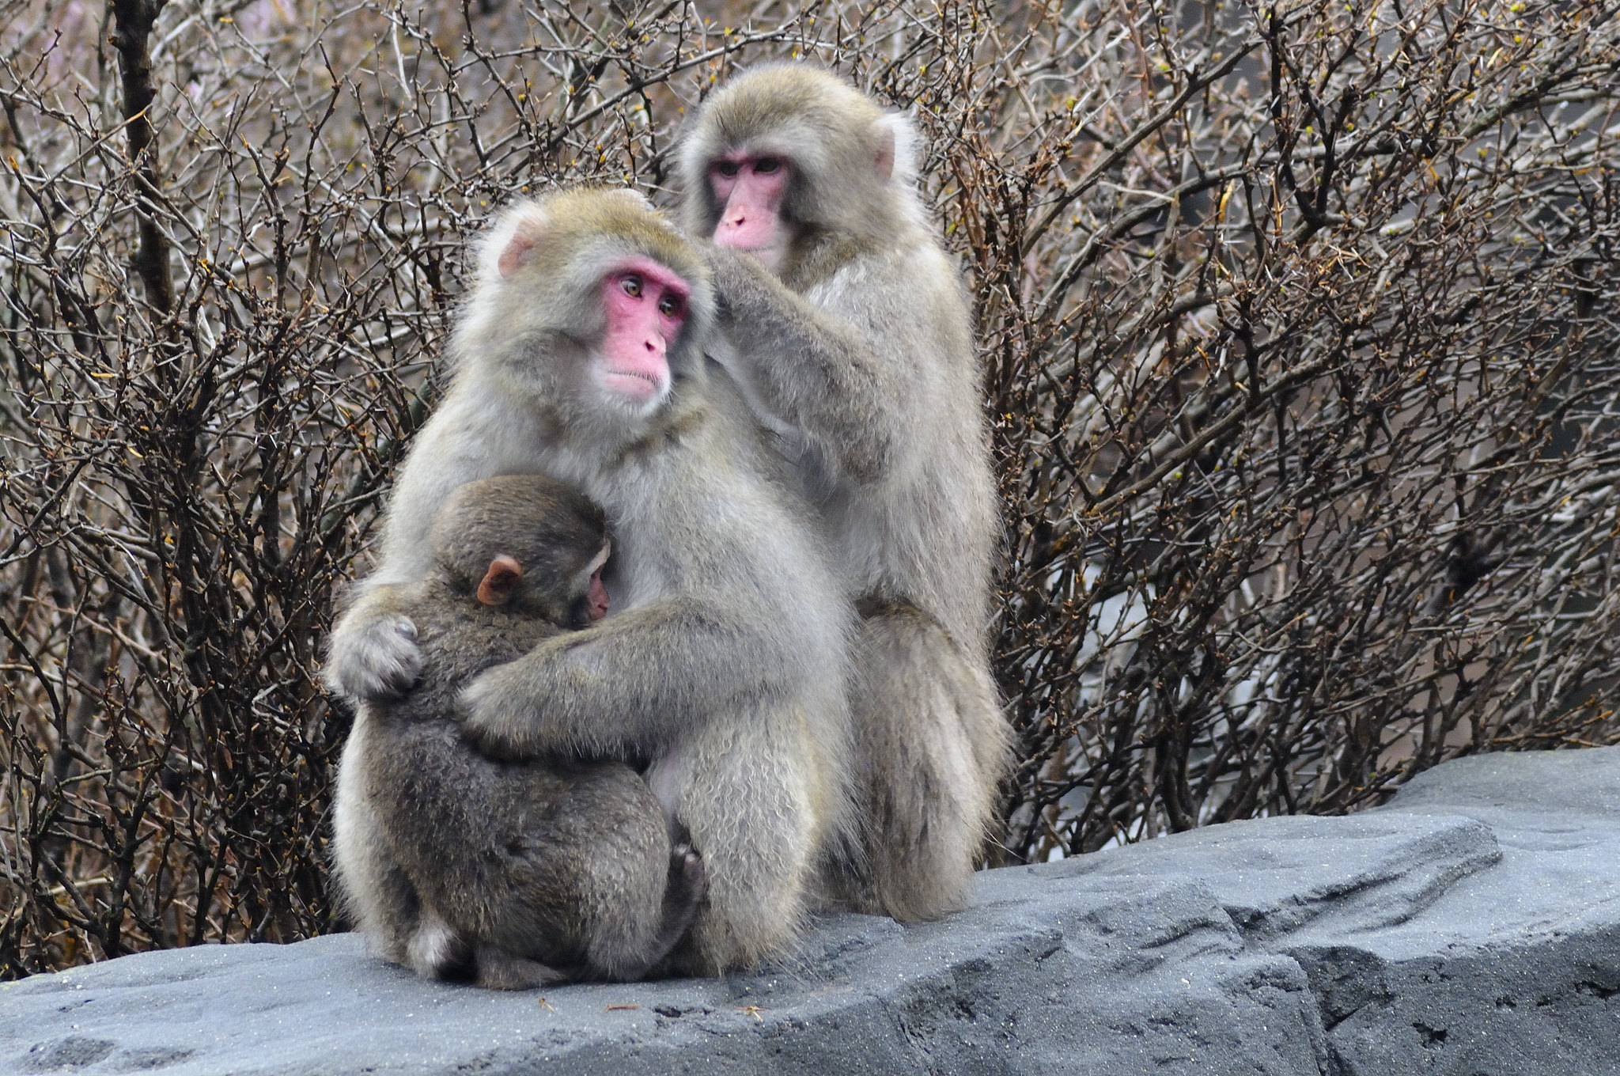
Title:
Monkeys

Slide 53
Author:
Chris Bloom

Slide 54
Licence:
CC BY SA 2.0

Slide 55
Source:
https://www.flickr.com/photos/bigshock/2433860127/in/photostream/

Slide 56
Publisher:
Flickr

Slide 57
Year:
2008

