Slide 1


Opening Up Copyright for Canadians: creating instructional videos that people want to watch (all the way to the end)
IcePops, July 20, 2023
Amanda Wakaruk
Copyright & Scholarly Communications Librarian, University of Alberta
With thanks to: Michael McNally and Julia Guy

Slide 2

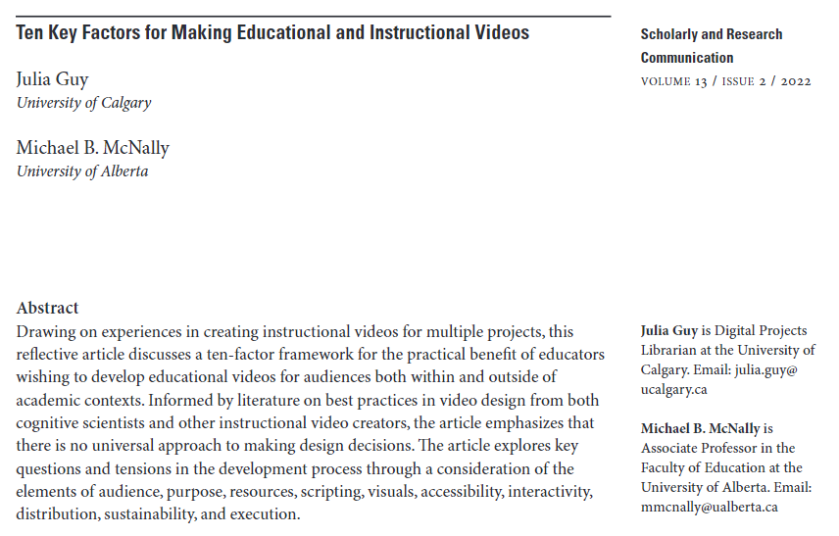
Audience
Purpose
Resources
Scripting
Visuals
Accessibility
Interactivity
Distribution
Sustainability
Execution
https://src-online.ca/index.php/src/article/view/423

Slide 3
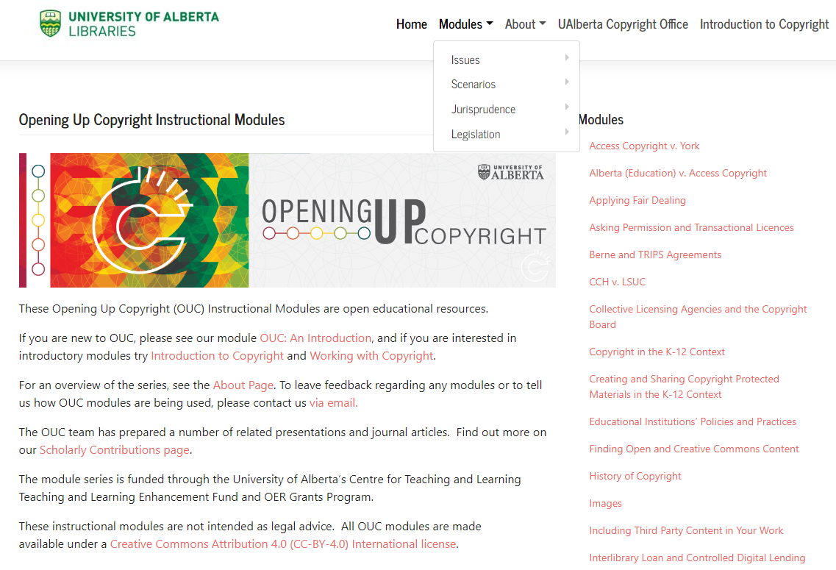
Overview
About Opening Up Copyright (OUC)
Ten factors, 3 (of 4) phases of development:
  Orienting the Project
  Content
  Usage
  Production
https://sites.library.ualberta.ca/copyright/

Slide 4





Opening Up Copyright
Grant funded series of openly licensed instructional videos on copyright
35 modules, most 6-8 minutes long
Range from more introductory subjects to ‘advanced modules’ on Copyright Act and key cases
Varied audiences including graduate students, instructors, librarians, and the general public

Slide 5






Phase 1: Orienting the Project
Who is your audience?
  Use appropriate language, examples, and images
  Audience motivation should inform design
What is the purpose of this video?
  Include clear learning objectives
  Consider both cognitive and affective elements
What resources do you need for this video?
  Space, time, money
Carmen
Professor Pam
Jesse
Taylor
Kyle
Bismeet

Slide 6
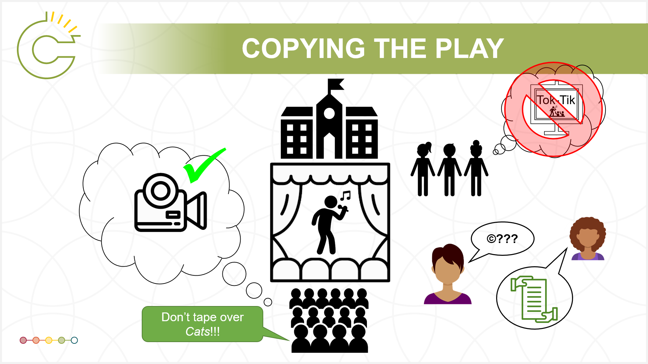
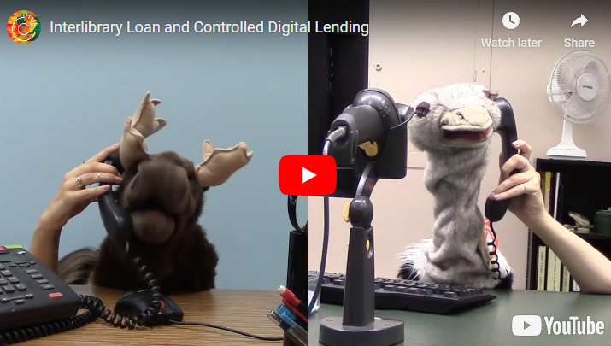
Phase 2: Content
Scripting: keep it clear and simple
  What information is essential?
  How can you simplify?
  What tone or style of speech fits your intended purpose?
  Keep running time between 3-6 minutes
Visuals
  How can you best use audio and images to convey this information?

Slide 7
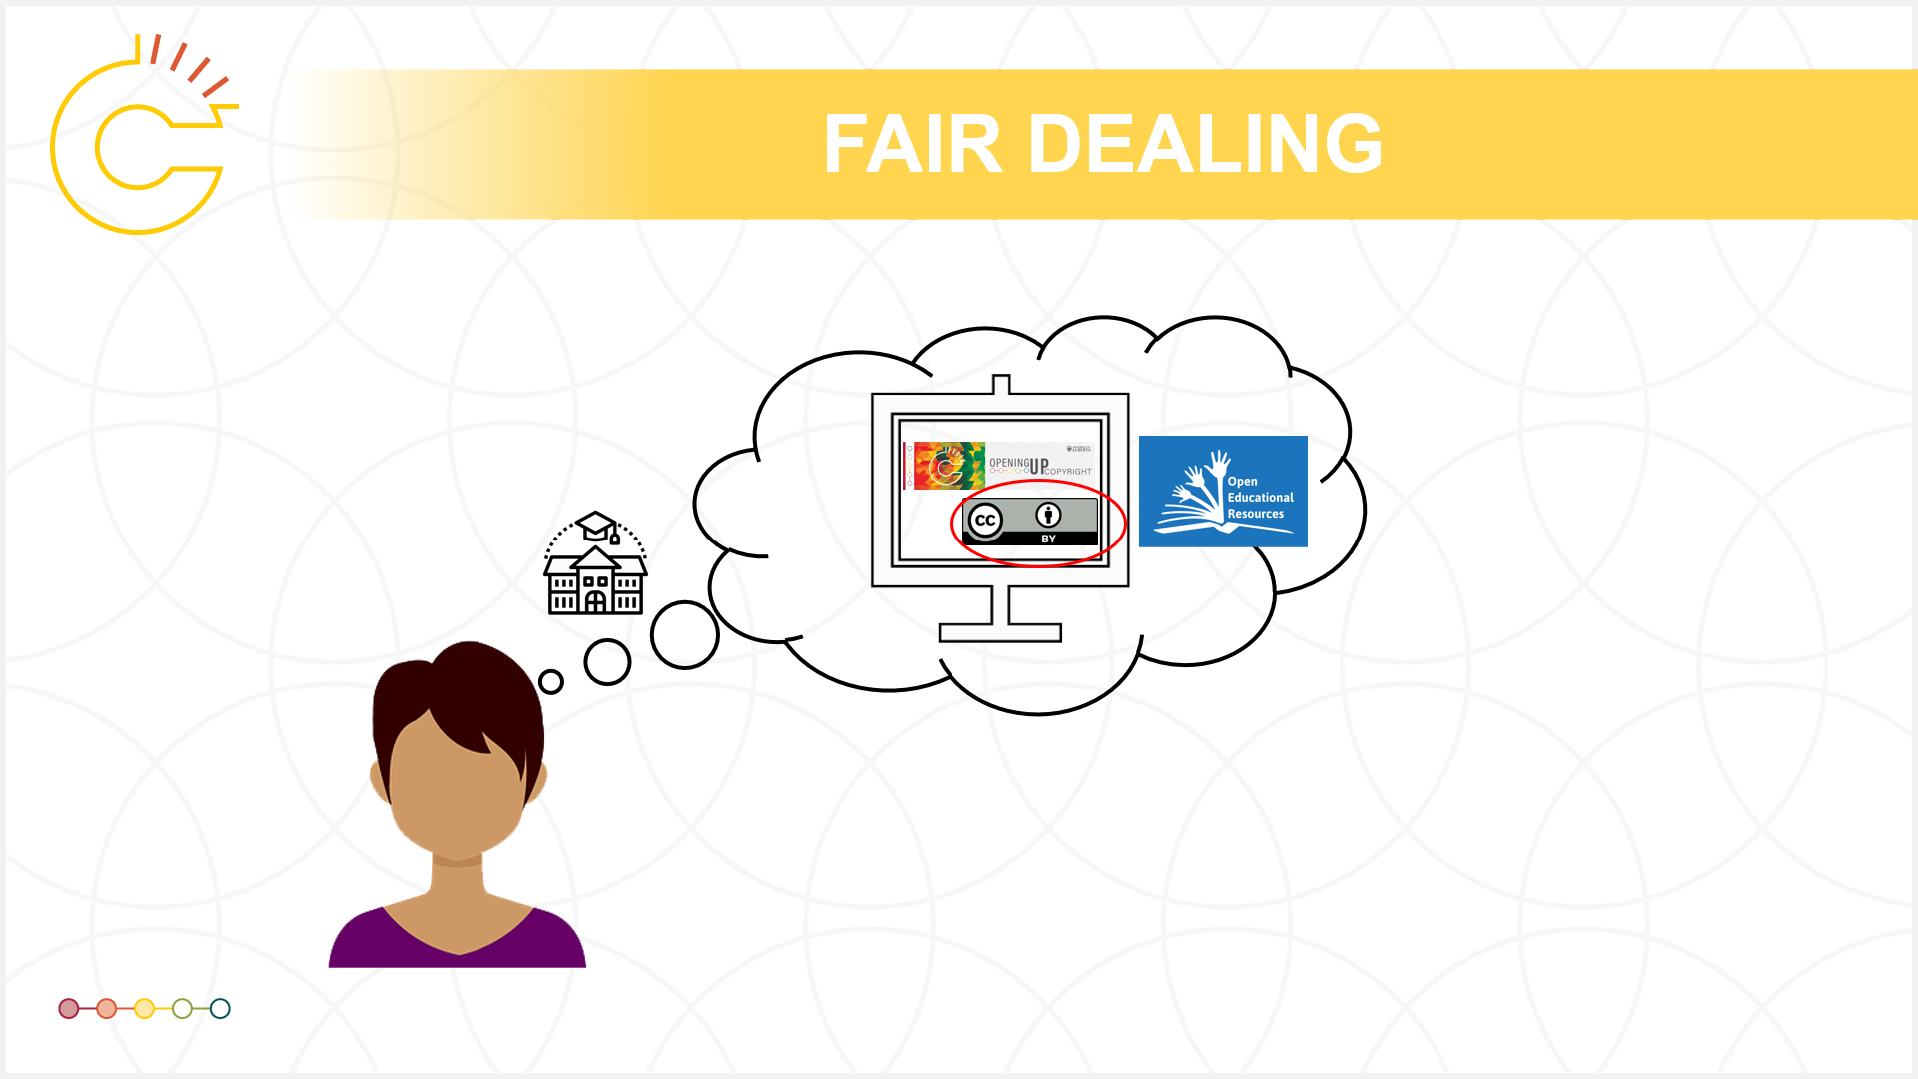
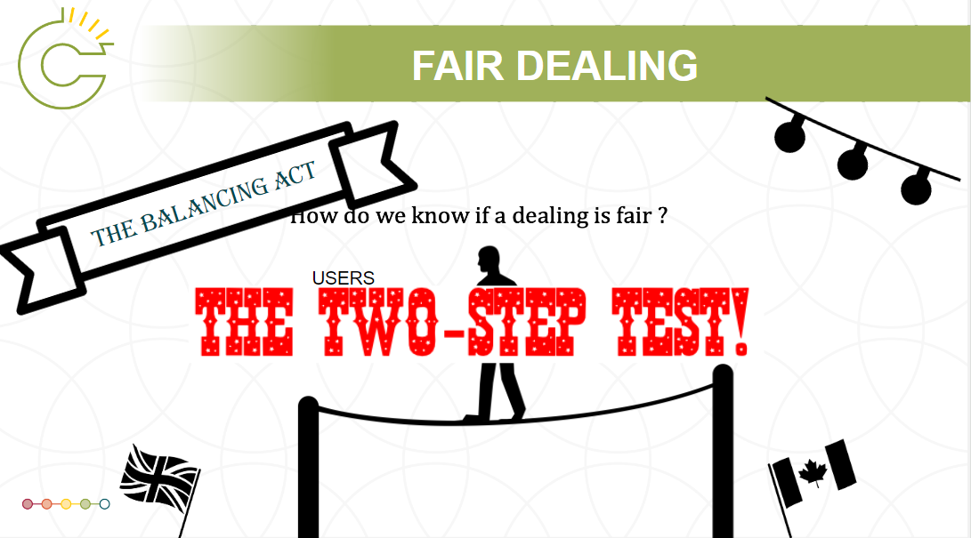
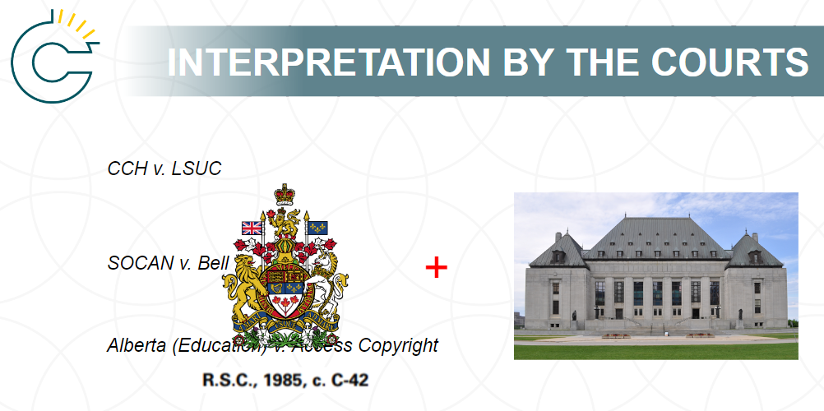
Phase 3: Usage
Accessibility
  At a minimum, use captions and audio descriptions of visuals
  Ensure that underlying materials available in multiple formats (scripts, slides, etc.)
Interactivity
  How do you want viewers to engage with this video?
  Use H5P to add pop-ups and quizzes
  Ask viewers to pause video and complete a learning task before continuing

Slide 8
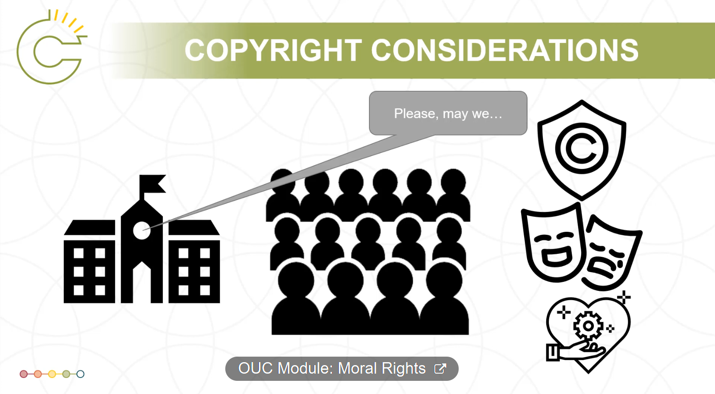
Phase 3: Usage
Distribution
  How can you make this video discoverable by the target audience?
  How open do you want this video to be?
  Select a video platform that provides captions, analytics, good discoverability
Sustainability
  Lengthen video life by using H5P for adaptation and changing narration not visual elements, when possible
  What might be the future uses of this video?

Slide 9
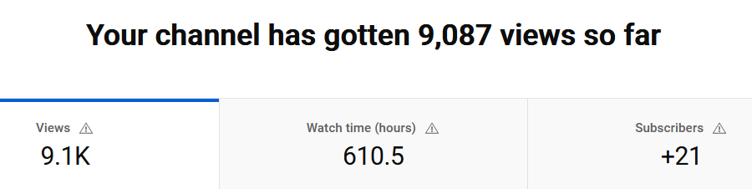
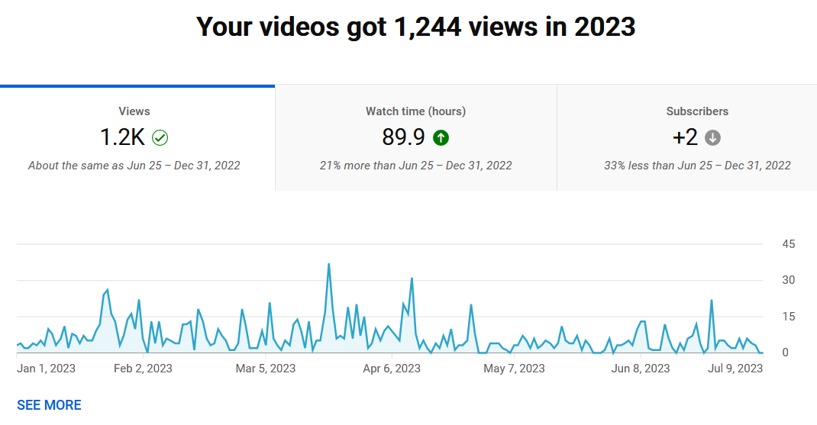
OUC usage statistics
Lifetime statistics (since Nov. 2018)

Slide 10
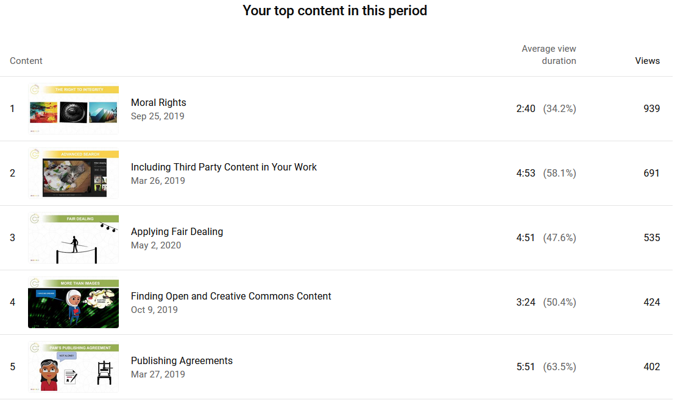
OUC usage statistics - Top 5

Slide 11
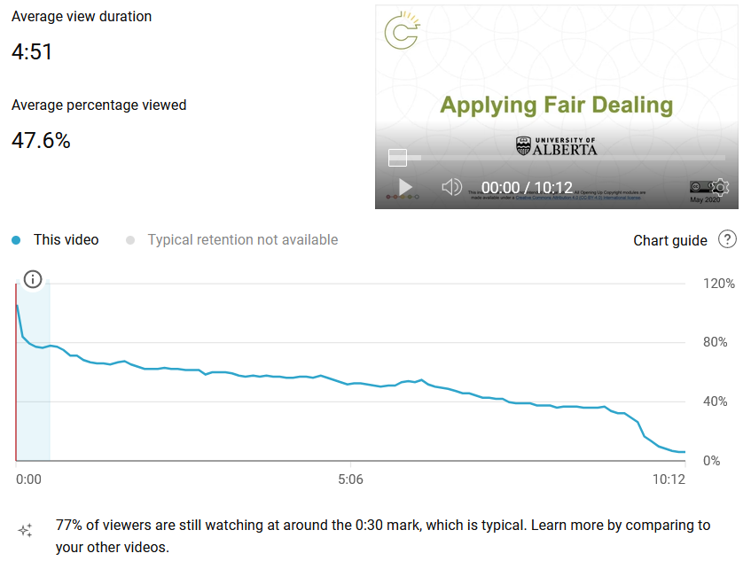
OUC usage statistics

Slide 12
Thank you.
Questions?
Follow-up
Amanda Wakaruk (amanda.wakaruk@ualberta.ca)
OUC (general email) (ouc@ualberta.ca)

