Slide 1

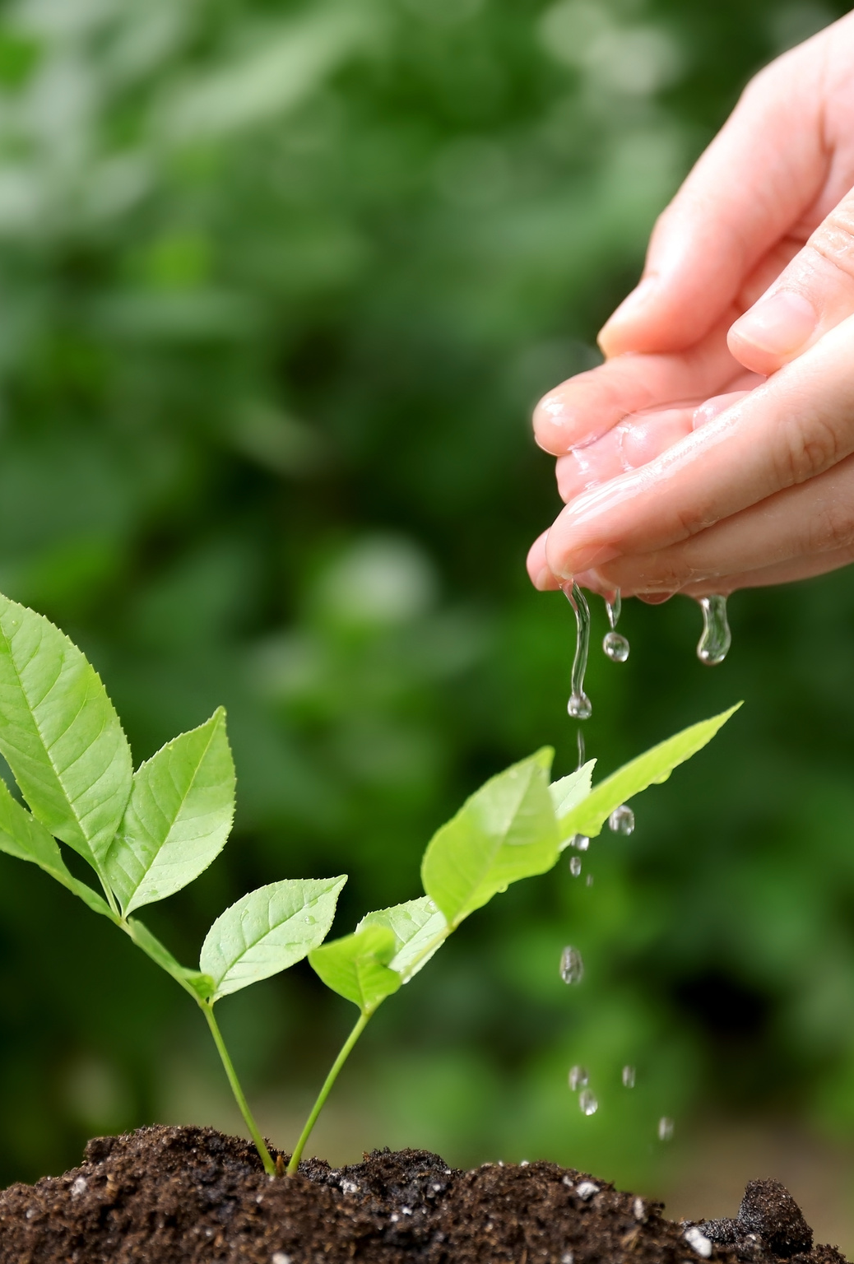


Cultivating Creative Commons Cognisance in Colleagues
CC education for PgCert HE participants
Jess Napthine-Hodgkinson
University of Manchester

Slide 2
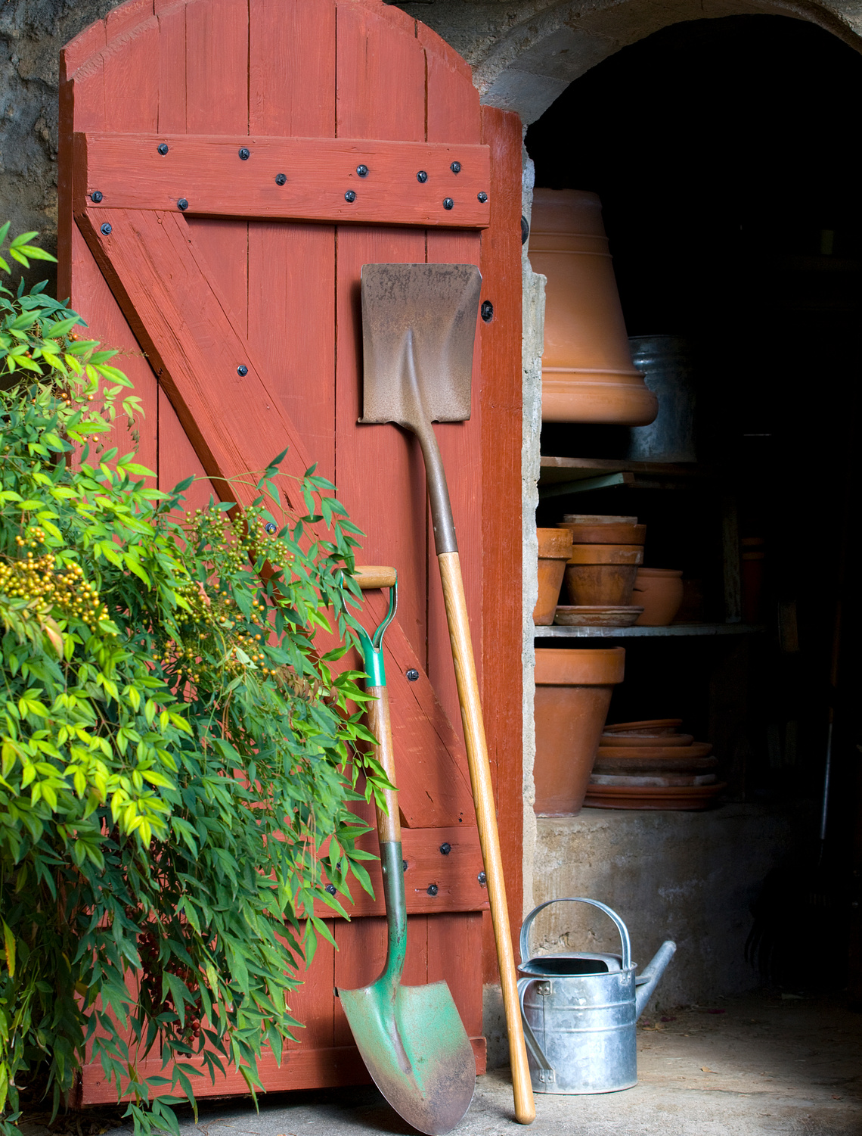
Open Knowledge in Higher Education
  Part of the PgCert HE at University of Manchester
  Available to academic and professional skills staff
  OKHE examines the context, contribution and constraints of openness in higher education
  Sessions – Open Practice, Open Research, Open Teaching

Slide 3
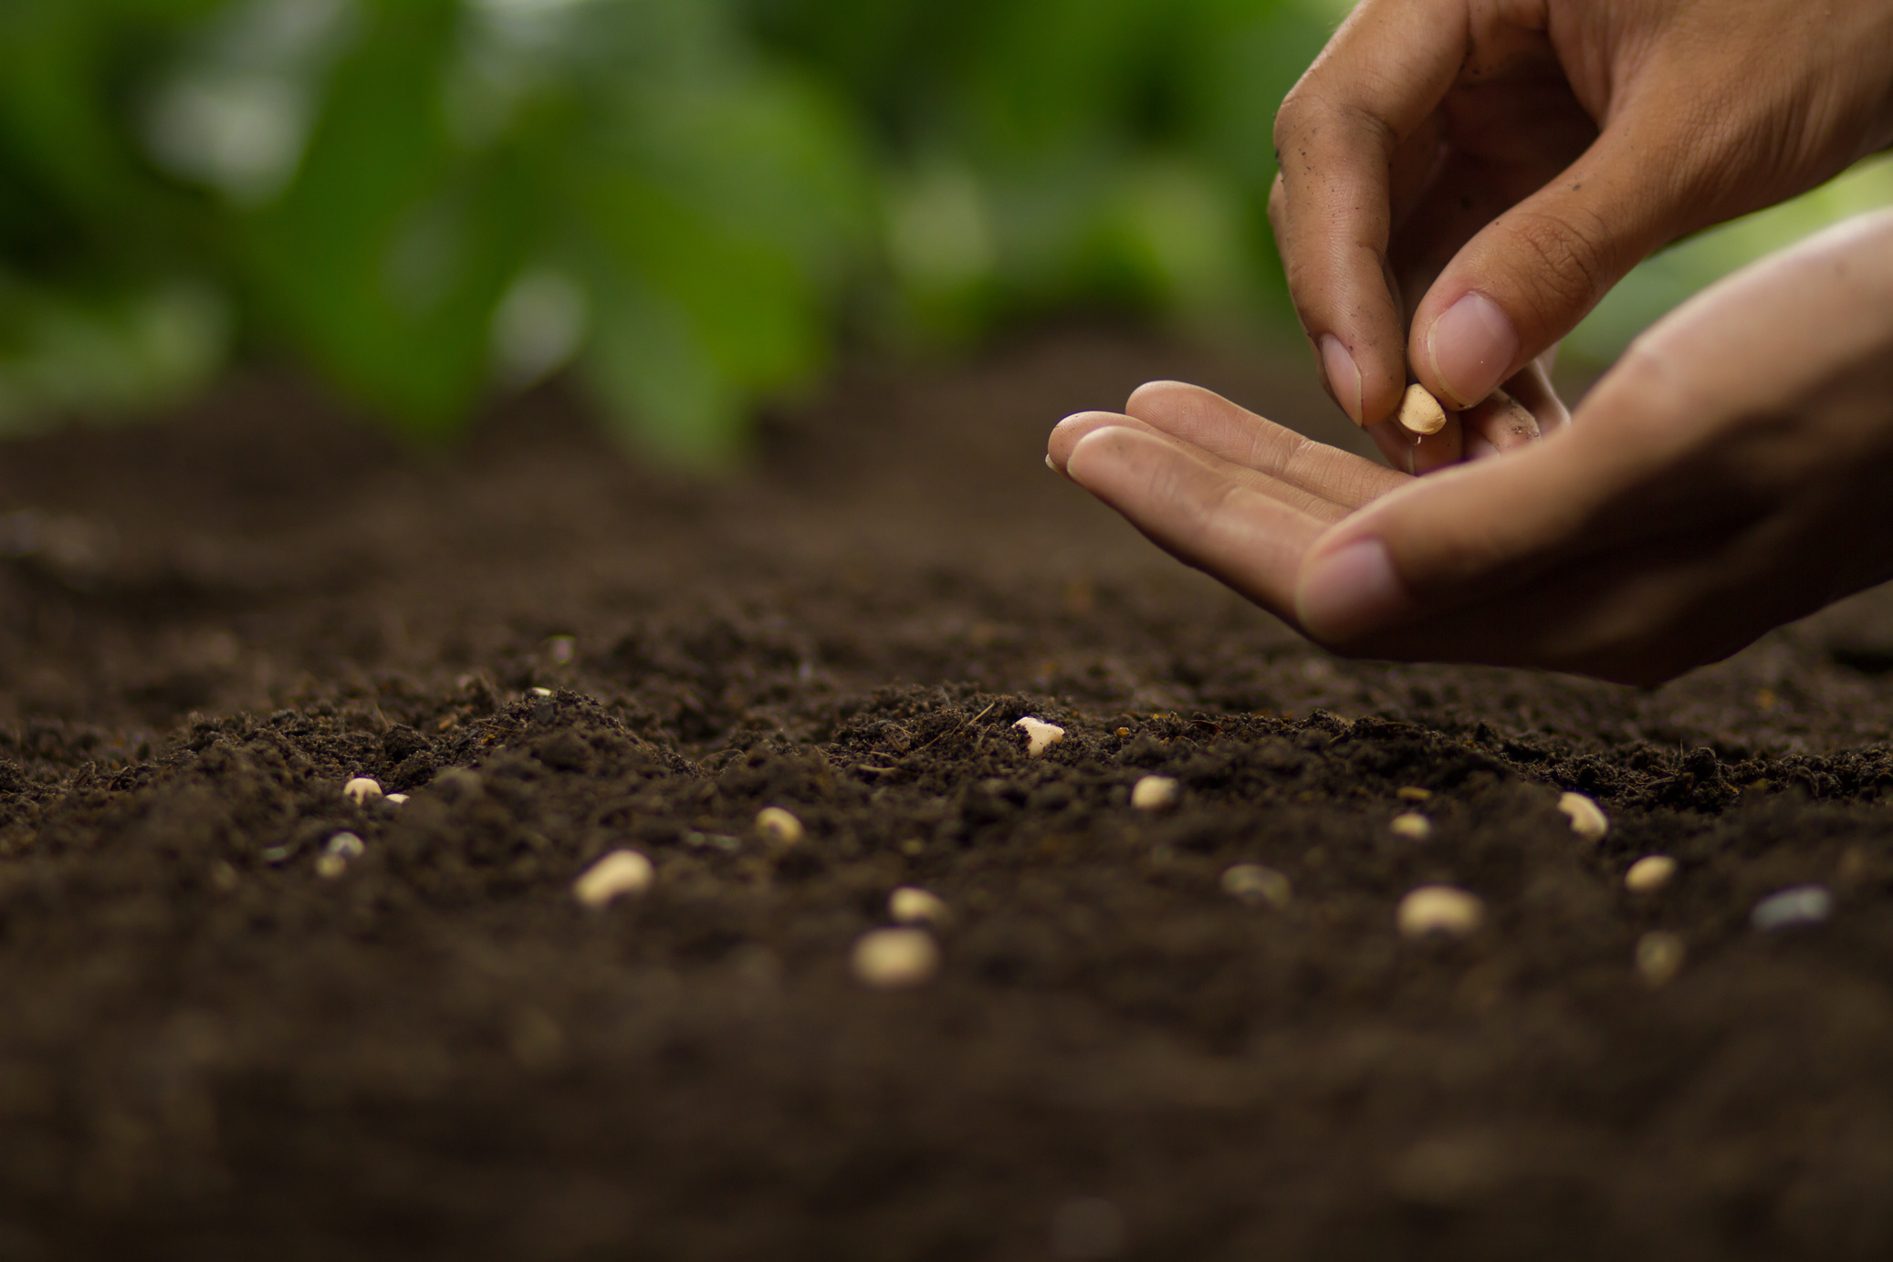
Practicing what we preach
  All course materials are open access
  Hosted on Medium
  Participants encouraged to submit assessments in blog format

Slide 4


Creative Commons
  Sessions reshaped to include more information on Creative Commons
  Reuse of unit tutor's assessment submissions for CC Certificate - renewable assessment in action!
  bit.ly/OKHECC

Slide 5


What next?
  How can we develop this CC content further?
  What other aspects of copyright education could we include?
  What other resources could we develop or point to?
  bit.ly/icepopsCC

