Slide 1
Is Intellectual Property Theft?
Mark Walford
20th July 2023

Slide 2

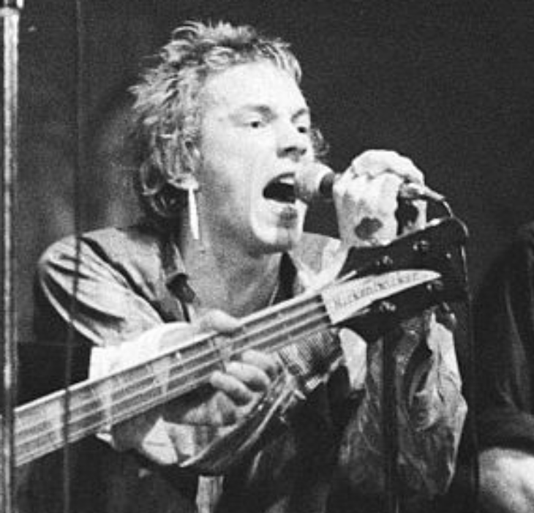
“Right now ha, ha, ha, ha, ha
I am an anti-Christ
I am an anarchist
Don't know what I want
But I know how to get it”
Agenda
What is anarchism?
Copyright and anarchism
Origins of Open access
Is intellectual property theft?
Resources

Slide 3
What is anarchism?
“Anarchism is a political philosophy and movement that is skeptical of all justifications for authority and seeks to abolish the institutions it claims maintain unnecessary coercion and hierarchy , typically including, though not necessarily limited to, governments, nation states and capitalism.”
  Wikipedia (19:42, 14/3/2023)

Slide 4
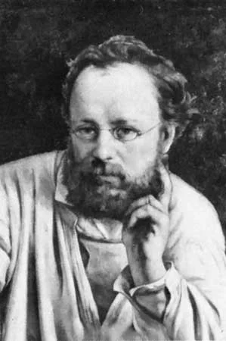
“Property is theft!”
Pierre-Joseph Proudhon
1840
‘Immaterial goods’ are public property
Rejected the idea that the creator owns the work
Creators should be rewarded fairly
All works are built on the labour of others
1862: Temporary sale privilege –period of exclusivity
1878:International Congress for the Protection of Intellectual Property
1886: Berne Convention

Slide 5
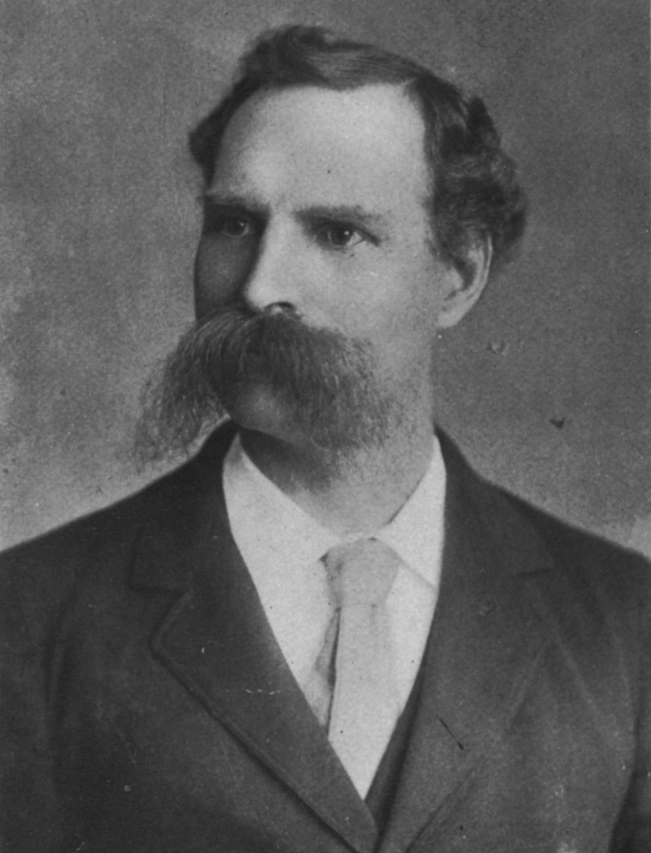
“My thoughts are my property as the air in my lungs is my property. When I publish my ideas, they become the property of as many persons as comprehend them. ”
James L Walker, The Question of Copyright, 1891-2
Key Ideas
Equal liberty
Alienable and inalienable property
Exclusivity, personal property and monopoly
Right to contract versus general injunction

Slide 6

“Information is power. But like all power, there are those who want to keep it for themselves. The world’s entire scientific and cultural heritage, published over centuries in books and journals, is increasingly being digitized and locked up by a handful of private corporations.”
Aaron Swartz
Guerilla Open Access Manifesto
Builds on James L Walker’s arguments
OA arguments based on better research outcomes came later
Fair Access to Science and Technology Research Act (2013-17)
OSTP, CoAS, RRS etc but also Sci-hub

Slide 7
Is intellectual property theft?
A personal view
Creators should have ability to control their work and receive benefit from it
Societal benefits are important, so balance is needed
Equal liberty is important but challenging in this context
Copyright legislation reflects this tension, e.g. fair use
Balance on rights about right
Balance on duration has gone too far towards copyright owners (and their descendants) - Proudhon’s ‘temporary sale privilege’

Slide 8
Resources
Wikipedia – pretty anarchist in its approach
The Anarchist Library: https://theanarchistlibrary.org/special/index
Demanding the Impossible, Peter Marshall, Harper Collins 1991
The Dispossessed, Ursula K. Le Guin, 1974 (Gollancz, 2002)

Slide 9


Slide 10








