Slide 1


COPYRIGHT AND ONLINE TEACHING IN A TIME OF CRISIS (XXVIII)
Hosted by the Association for Learning Technology
Chris Morrison & Jane Secker
University of Kent & City, University of London
Friday 18 December 2020

Slide 2
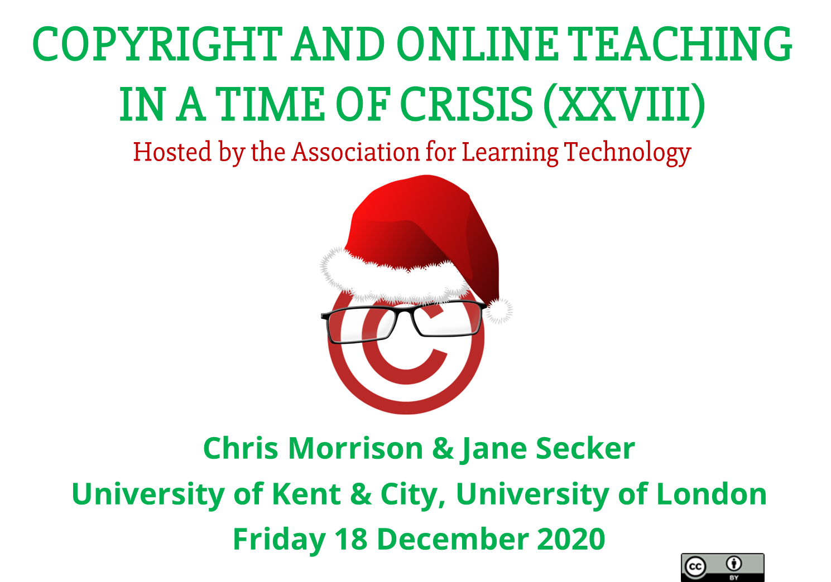

Slide 3

TODAY’S WEBINAR
Copyright news
  BoB Online EU access
  CoOL Gang Update
  IFLA / gathering education resources - reminder
  Orphan works survey
  Research Support Games Day
2. Christmas IP Quiz – just what the doctors ordered
  Dr Emily Hudson
  Dr Jane Secker
3. Copyright Give Us a Clue
4. Christmas Singalong
5. Future webinars

Slide 4
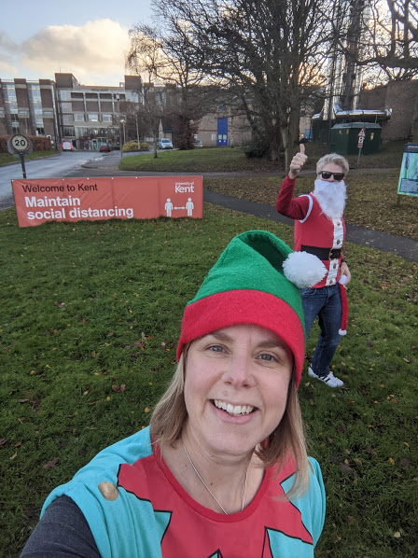
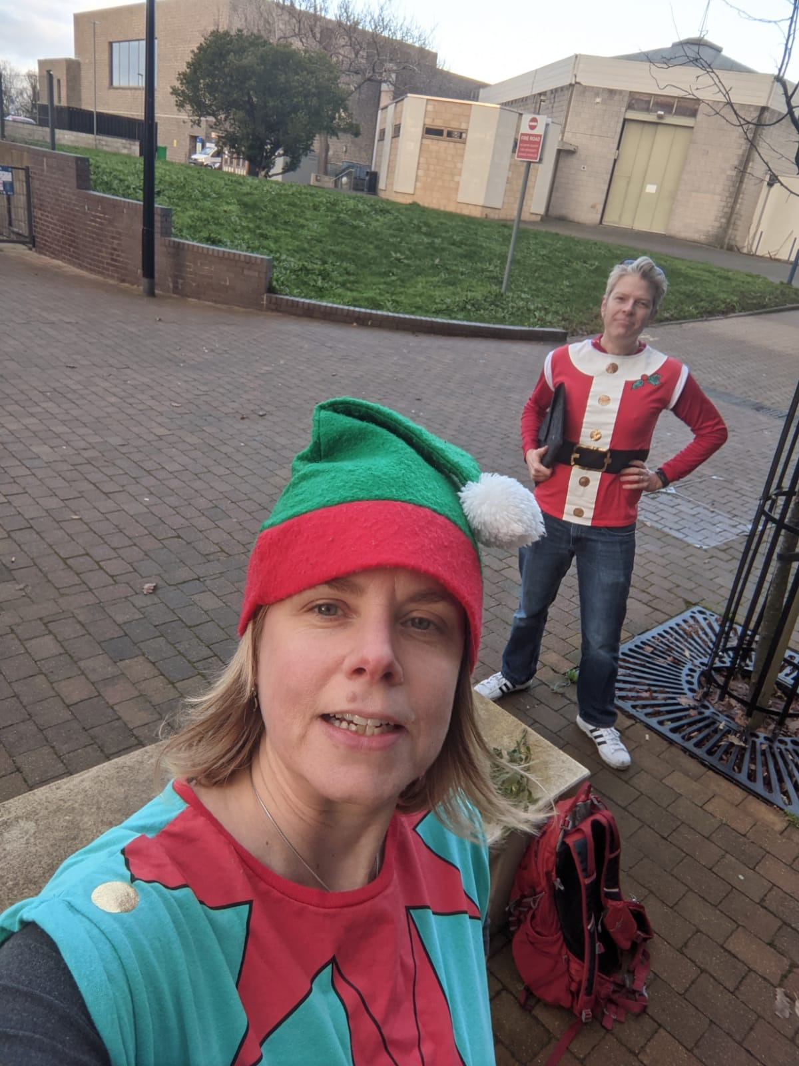
THIS WEEK…

Slide 5

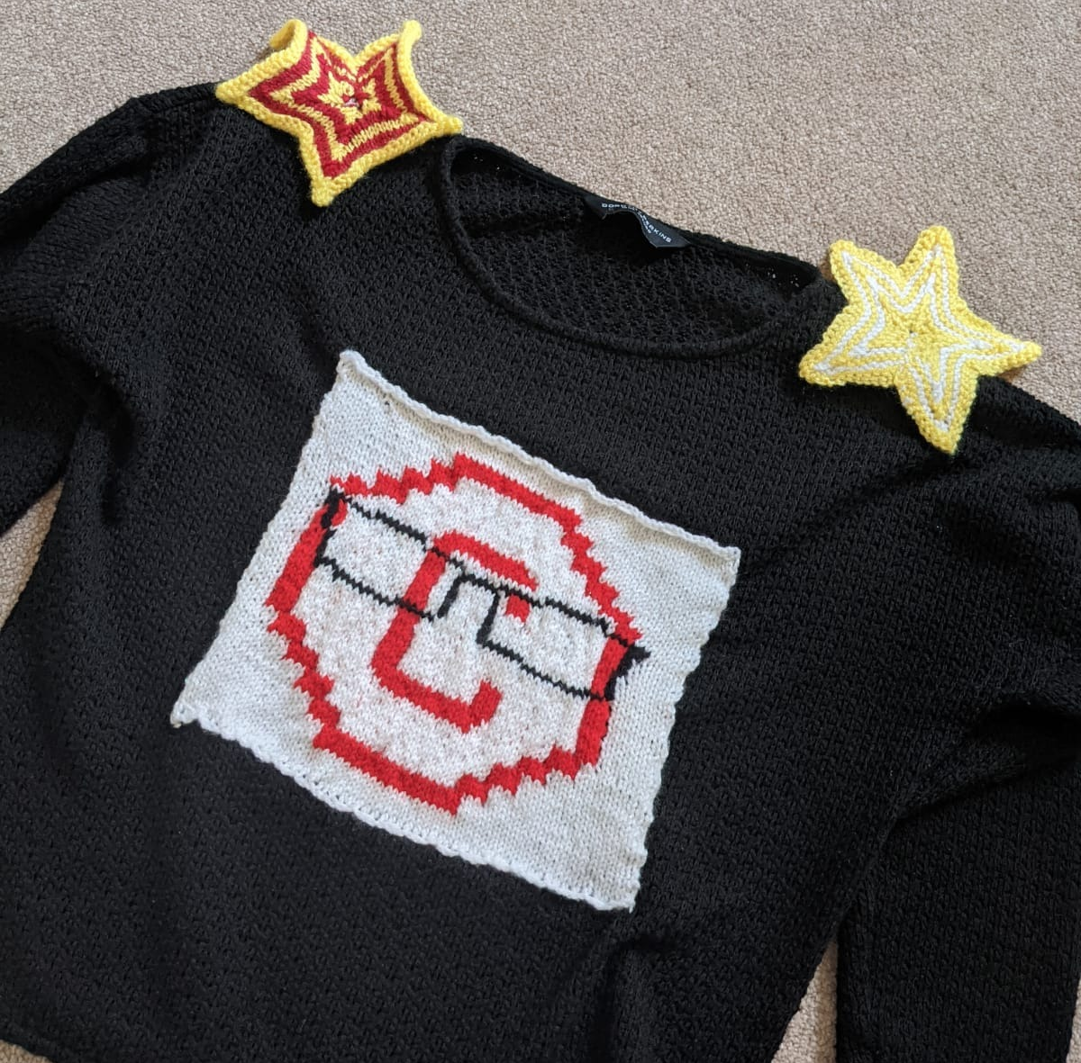
WITH THANKS TO…
Stars by Emma Duke-Williams @Emmadw
Copyright Literacy Logo by Lucy McCaul @LucyMcCaul
Consider donating to: https://www.trusselltrust.org/

Slide 6
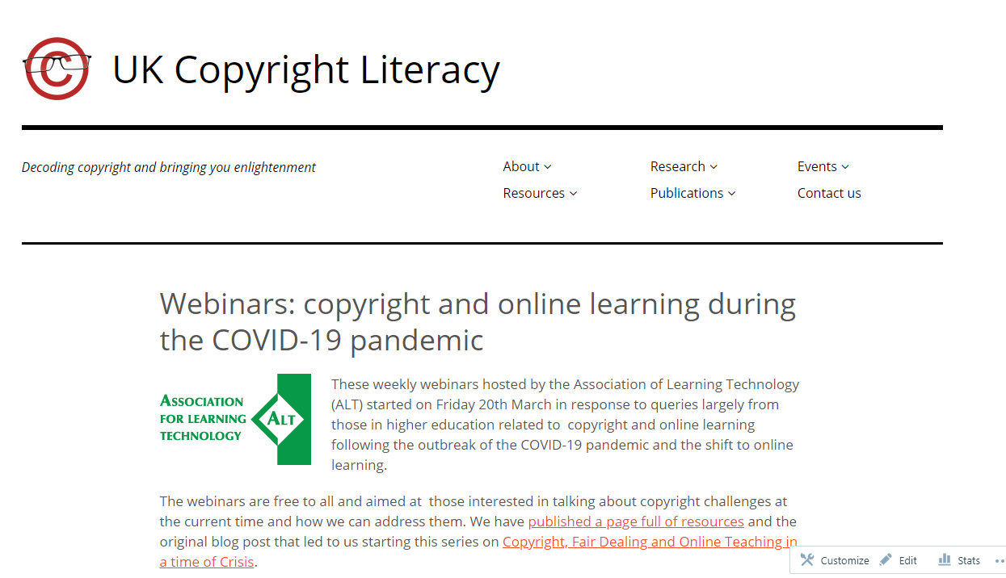
WEBINAR AND BLOG ARCHIVE
https://copyrightliteracy.org/upcoming-events/webinars-copyright-and-online-learning/

Slide 7
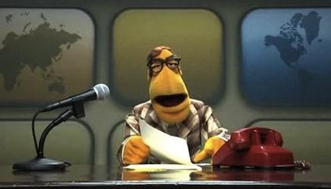

Image: Muppet News Flash

Slide 8


BOB ONLINE EU ACCESS
We will no longer be able to legally provide BoB access to UK registered students in the EU after 31st December 2020. This is because the UK will no longer be covered by the relevant EU portability legislation.
Any UK registered students in the EU will not be able to access BoB (apart from the BBC News Channel* ) from 1st January 2021.

Slide 9


COOL GANG UPDATE
Areas of Activity
Accessibility and copyright
ALT ethical framework
IFLA request for copyright education and training resources
Codes of fair practice
Collaborations and partnerships
International representation and networking
Other sectors than HE - schools and FE
Padlet – tinyurl.com/CoOLSIGPadlet
Menti: https://www.menti.com/qhx1wp3nx4
registration link: tinyurl.com/CoOLSIG

Slide 10
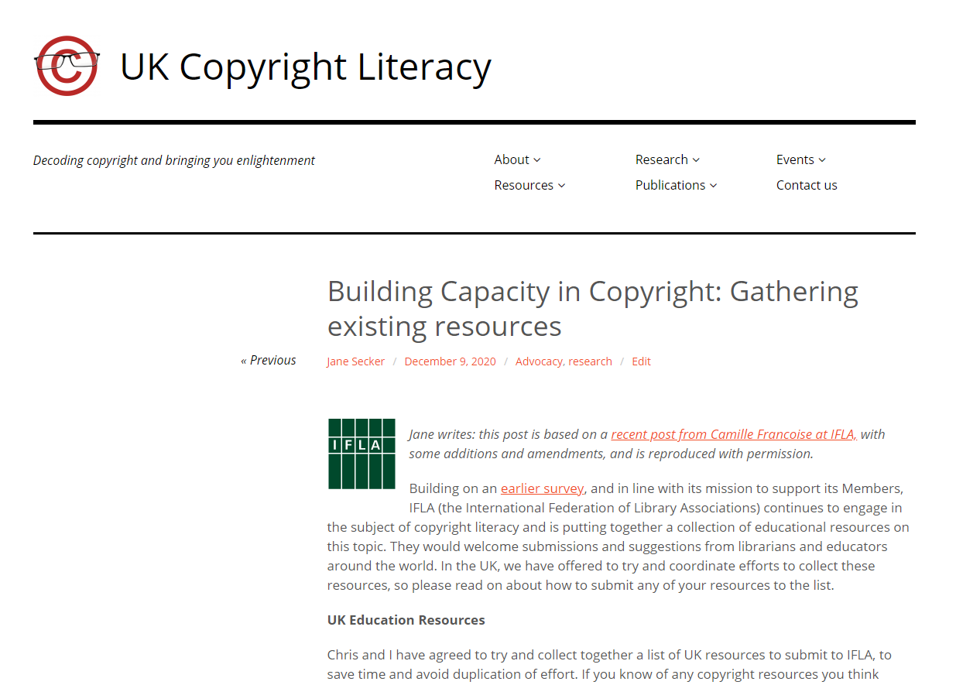
IFLA COPYRIGHT RESEARCH
https://copyrightliteracy.org/2020/12/09/building-capacity-in-copyright-gathering-existing-resources/

Slide 11
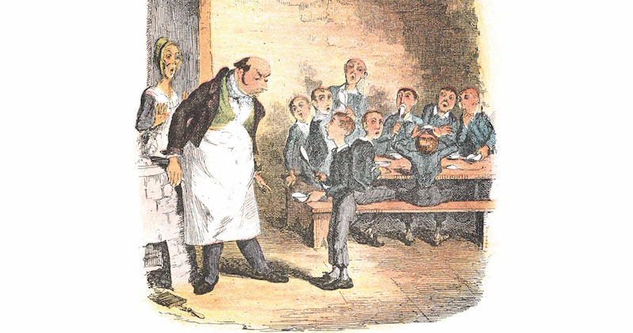
ORPHAN WORKS SURVEY
https://edinburgh.onlinesurveys.ac.uk/orphan-works-survey-laca-and-the-university-of-edinburgh-2

Slide 12
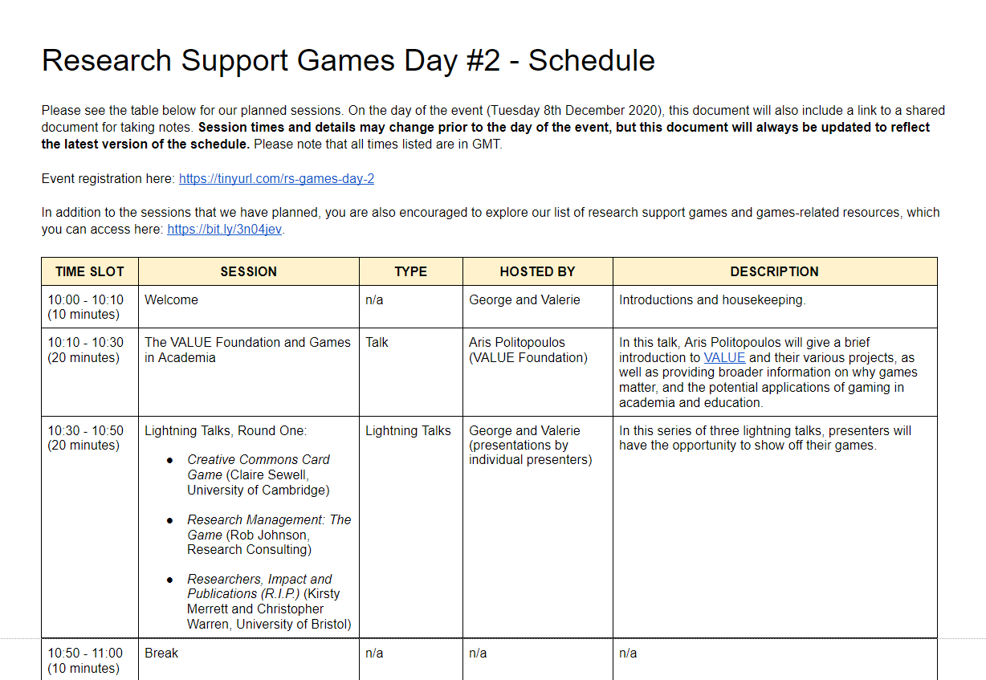
RESEARCH SUPPORT GAMES - recordings
Tuesday 8 December – 10am – 5pm
https://rgu-repository.worktribe.com/output/1005411

Slide 13
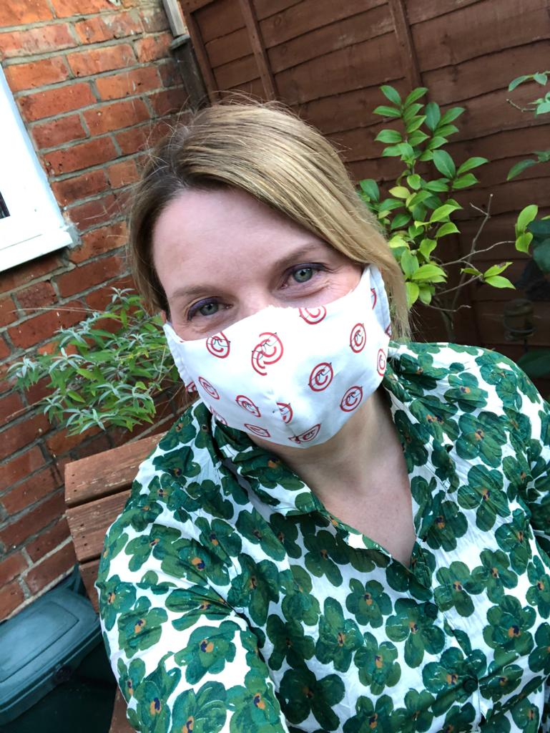
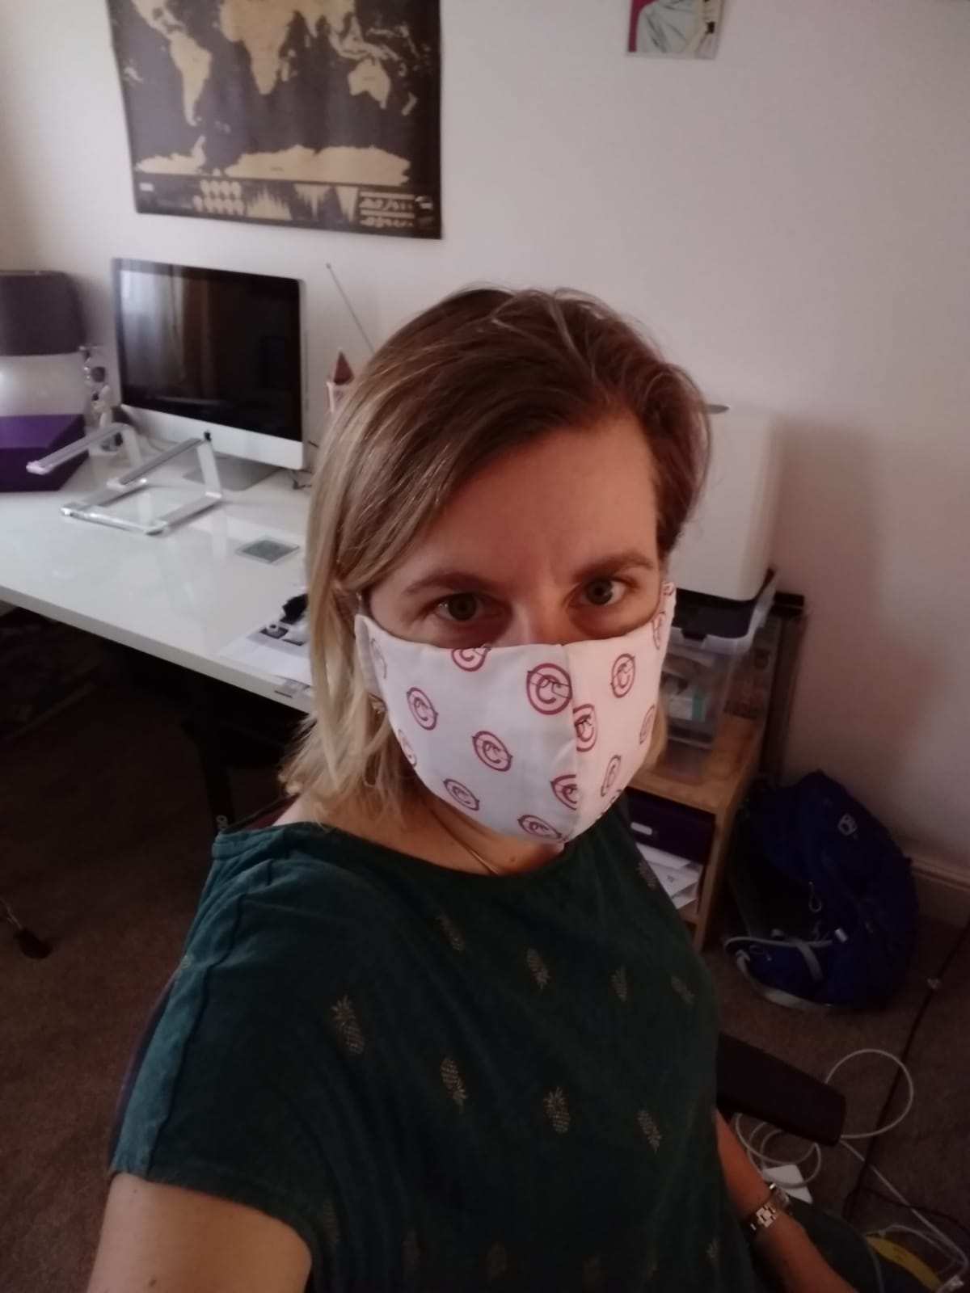
JUST WHAT THE DOCTORS ORDERED QUIZ

Slide 14

GIVE US A (COPYRIGHT) CLUE

Slide 15

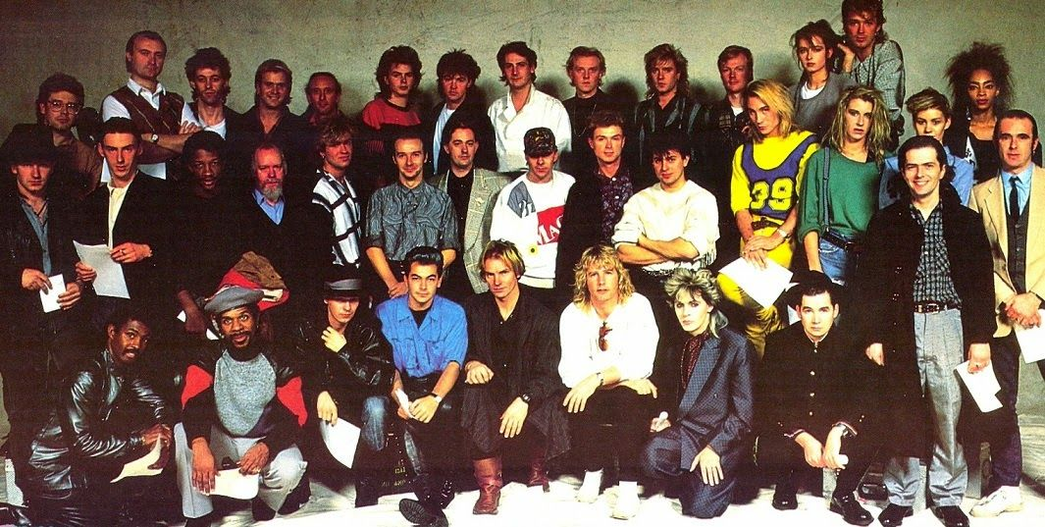
DO THEY KNOW IT’S CHRISTMAS?

Slide 16
FUTURE WEBINARS
Next webinar 15th Jan 2021 at 2pm
Carys Craig and Bob Tarantino: Lessons from the Pandemic
Future topics
International copyright literacy
CoOL Gang Activities
More from Dr Emily Hudson…

Slide 17
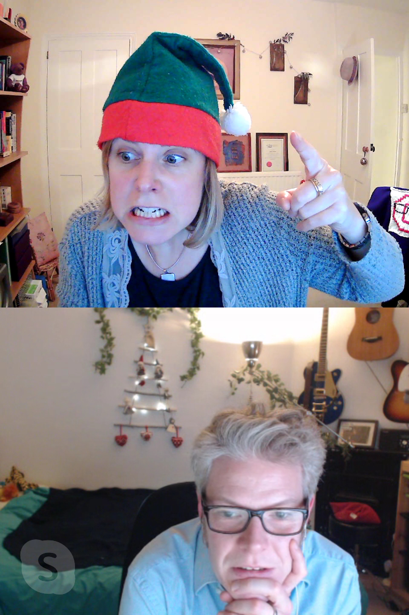
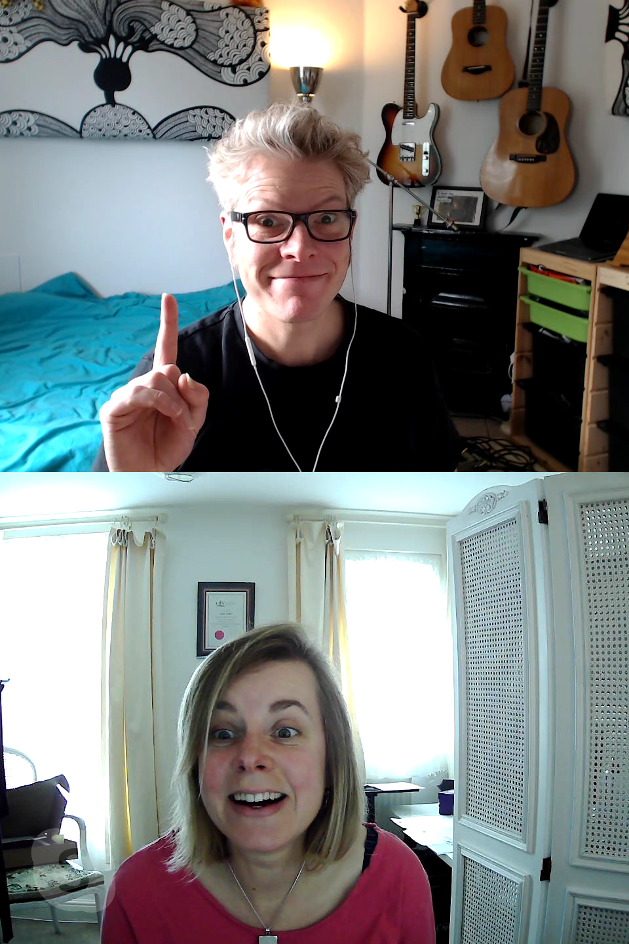
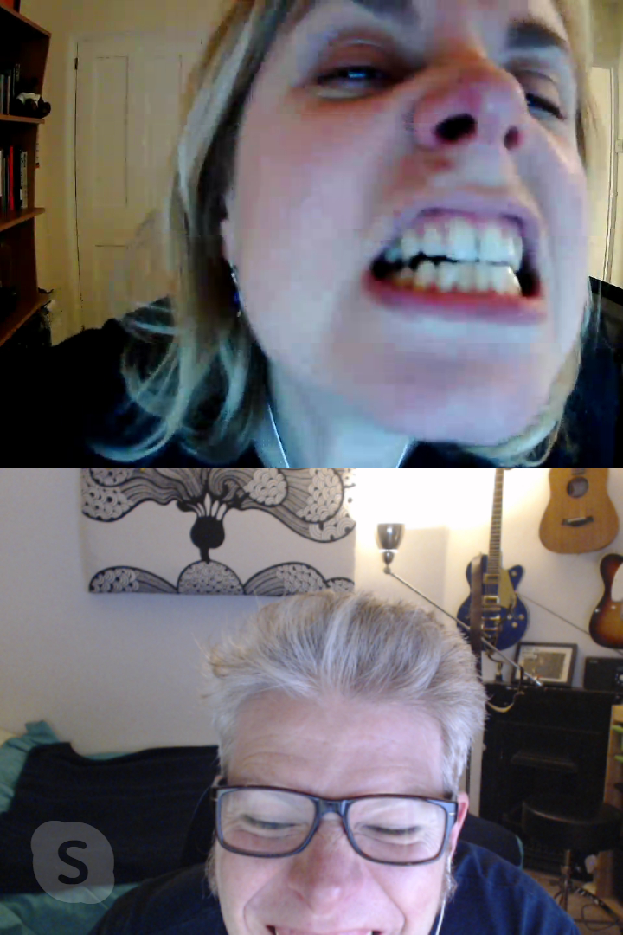
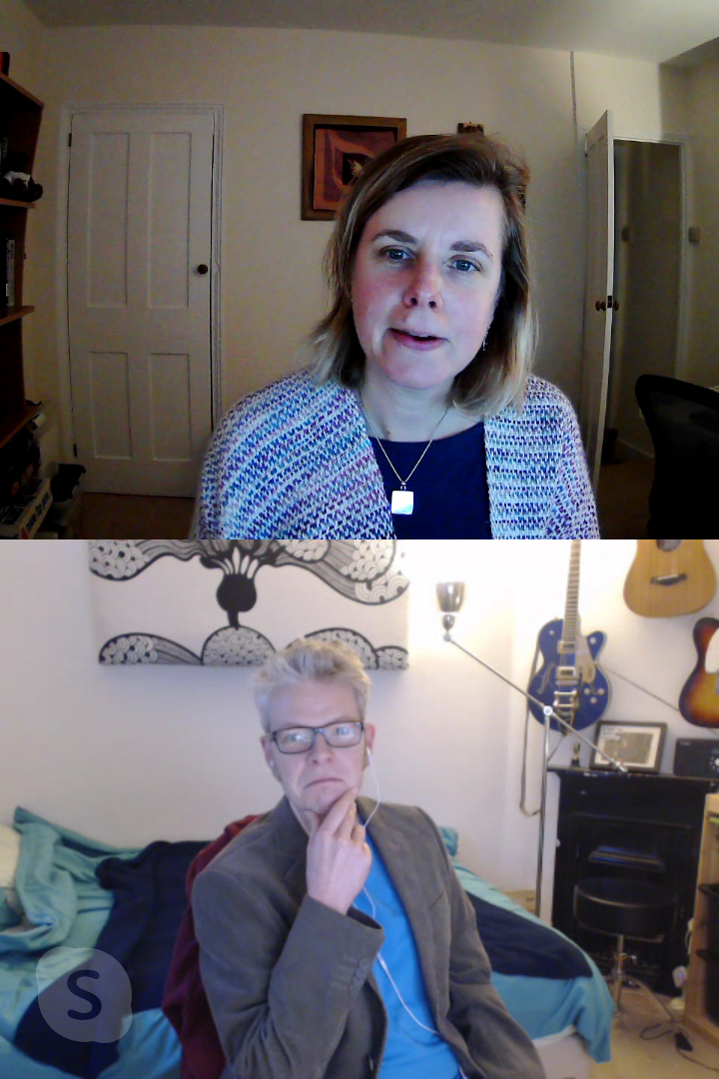
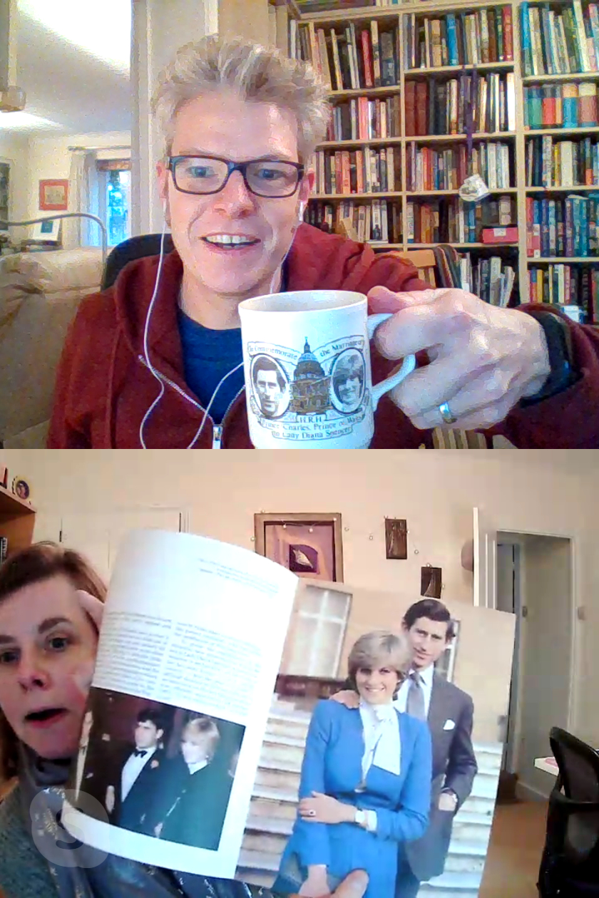
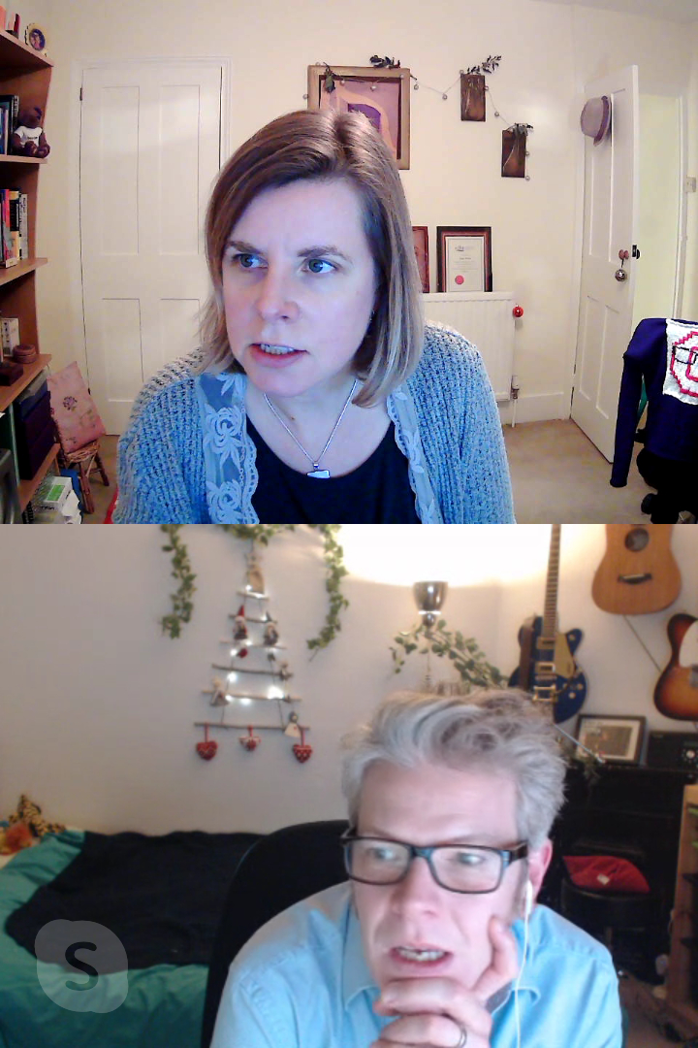
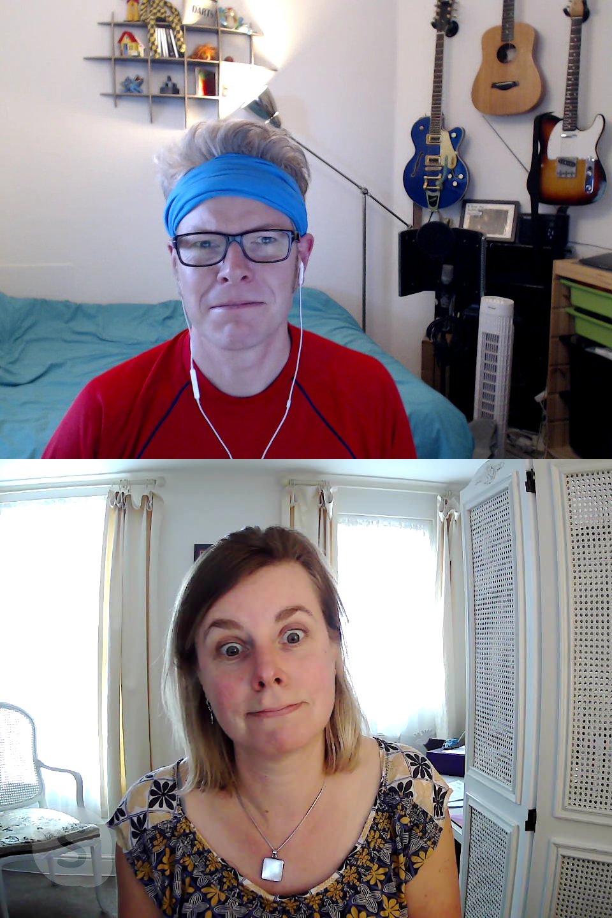
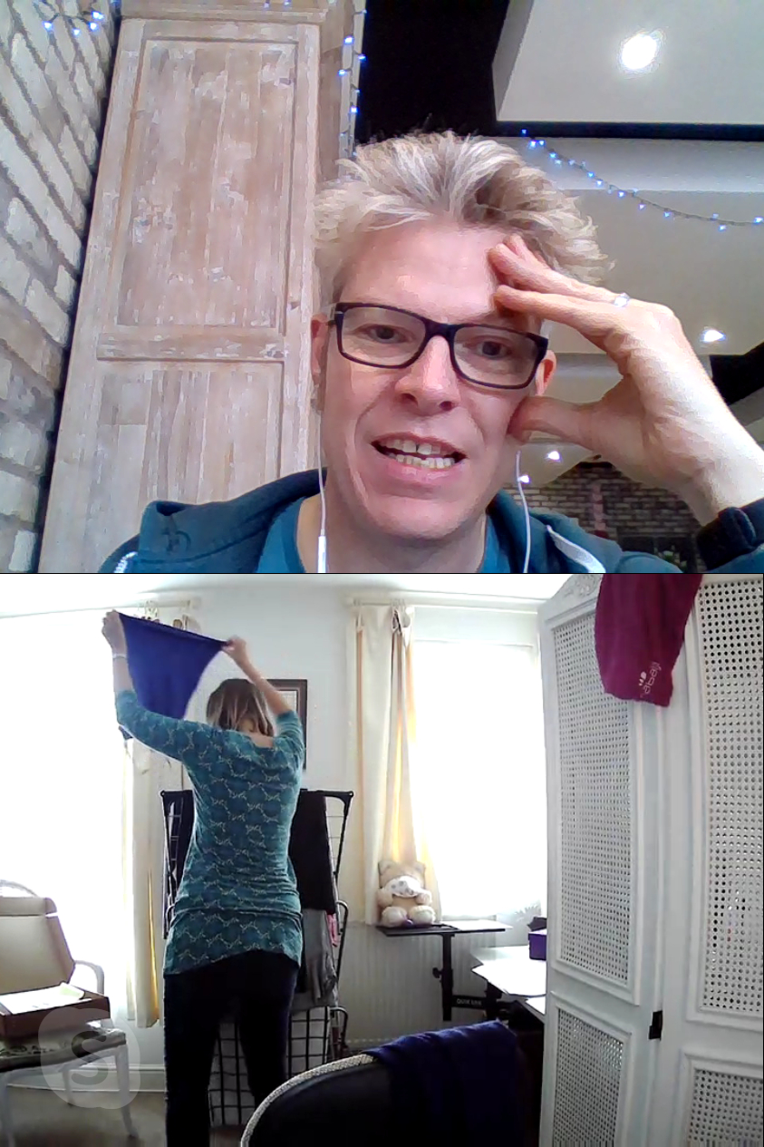

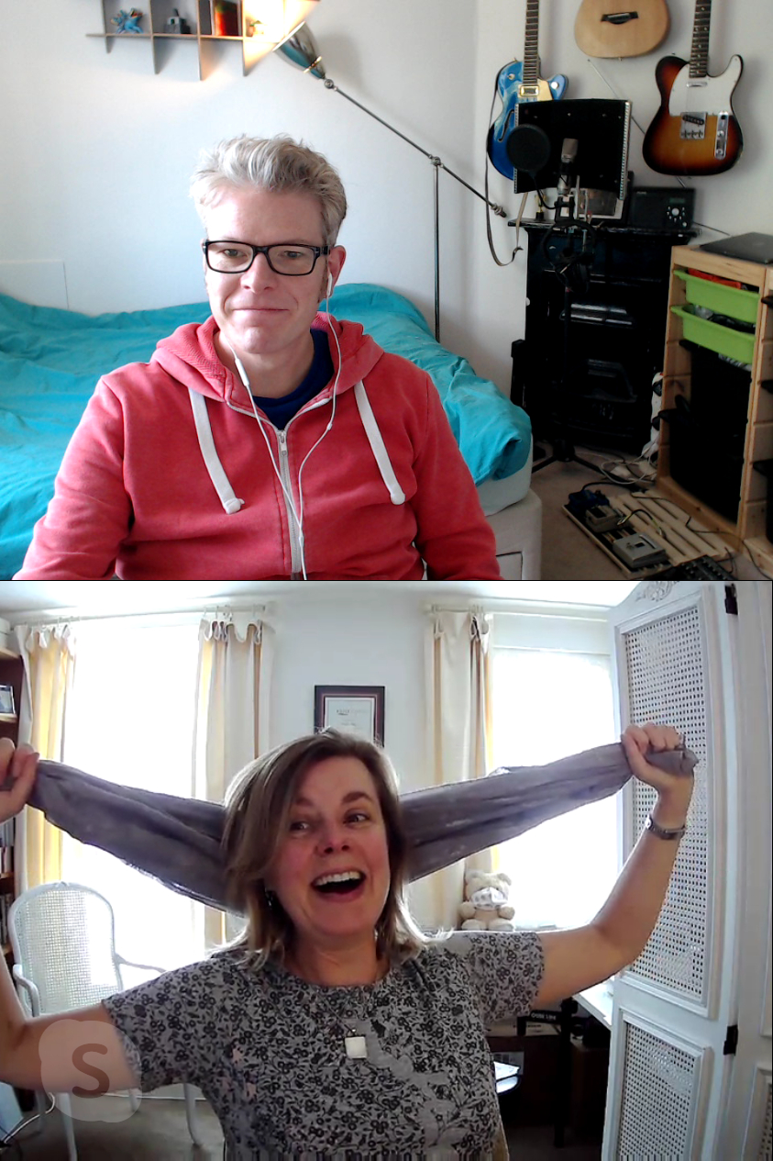

ONE LAST THING…
MERRY CHRISTMAS EVERYONE

