Slide 1
Train the Trainer, Spread the Word: Looking to Library Associations as Copyright Literacy Multipliers
Lisa Janicke Hinchliffe
Professor, University of Illinois at Urbana-Champaign &
Chair, IFLA Information Literacy Section
Stephen Wyber
Policy and Advocacy Manager,
International Federation of Library Associations (IFLA)

Slide 2
Library associations can play a key role in identifying priority areas for collective action and providing professional development to catalyze and support libraries and library workers in taking action.

Slide 3
IFLA STRATEGIC PLAN 2016-2021
STRATEGIC DIRECTION: 2. INFORMATION & KNOWLEDGE
We will build a framework that promotes equitable access to information and knowledge in any format and in any place. We will establish the capacity for libraries to act as catalysts of innovation, able to facilitate the creation and re-use of content by their communities.
Activity 2.2: Advocating for an equitable copyright framework.

Slide 4
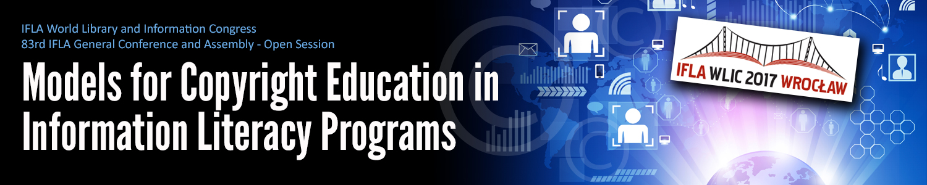

Slide 5
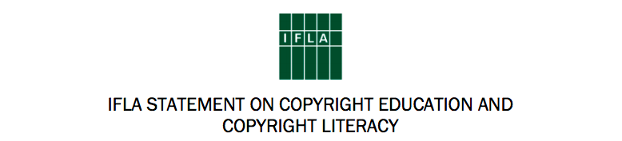
“Copyright literacy can be defined as sufficient copyright knowledge to be able to take well informed decisions on how to use copyrighted materials. It includes understanding the structure, functioning and implications of the copyright system, as laws, practices, and user expectations evolve. Copyright education is the process of developing and updating copyright literacy.”

Slide 6
Library associations should:
Ensure that comprehensive copyright literacy is included in competencies for library professionals, working with library educators, and explore the possibilities to provide guidelines or certification.
Advocate for stronger exceptions and limitations in order to maximise access to information.
Act as fora for the exchange of expertise and best practice to raise the standard of provision of copyright education and, where possible, produce practical guides on copyright literacy for practitioners, as well as workshops and conferences.
Collect and publish empirical data on copyright literacy initiatives for both pre- and in-service training to ensure continuous improvement of the copyright education programmes. Such data will also support advocacy activities.

Slide 7
Theory of Impact
IFLA Supports Library Associations
Library Associations Provide Professional Development to Library Workers
Library Workers Educate Library Users

Slide 8
Professional Development
Content Framework
Copyright Literacy Education
Copyright Literacy
Pedagogical Literacy

Slide 9
Evidence-Based Approach –
Inquiry Questions
How do library associations support copyright literacy professional development for library workers?
How do library associations support copyright education professional development for library workers?
What could IFLA do to support library associations in this work?

Slide 10
Project Plan
Phase 1: Case Studies (Summer 2019)
  Website Analysis
  Interviews with Library Association Staff and Members
Phase 2: Global Survey (Fall 2019)
Phase 3: Develop Materials to Support Building Strong Library Associations (2020)

Slide 11
Phase 1: Case Studies –
Preliminary Results
Library association websites do not represent the breadth and depth of activity in this area.

Slide 12
Phase 1: Case Studies –
Preliminary Results
Library association websites do not represent the breadth and depth of activity in this area.
Library association staff expertise and effort varies. May be member-led or staff-led.

Slide 13
Phase 1: Case Studies –
Preliminary Results
Library association websites do not represent the breadth and depth of activity in this area.
Library association staff expertise and effort varies. May be member-led or staff-led.
Library associations are focused on copyright advocacy and library worker copyright literacy with no/minimal effort to copyright literacy education.

Slide 14
Phase 1: Case Studies –
Preliminary Results
Library association websites do not represent the breadth and depth of activity in this area.
Library association staff expertise and effort varies. May be member-led or staff-led.
Library associations are focused on copyright advocacy and library worker copyright literacy with no/minimal effort to copyright literacy education.
Library associations are interested in copyright literacy education and see this is a future growth area of importance.

Slide 15
Questions for Discussion & Dialogue
What drives library association activity in copyright literacy and copyright literacy education?
What would be useful for IFLA to provide?
Case studies (website analysis and/or interviews) thus far – Australia, Canada, Germany, New Zealand, and South Africa. Nominations?

Slide 16
Next Update
IFLA WLIC in Athens
Session 221: Copyright Education – Information Literacy
August 28, 2019, 11:45-12:45

