Slide 1

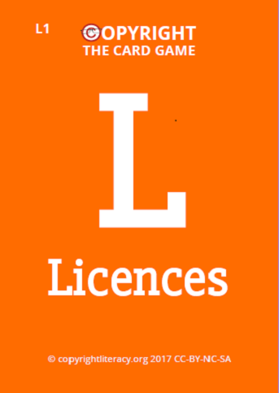
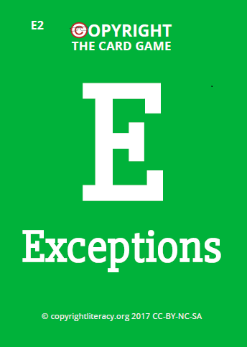

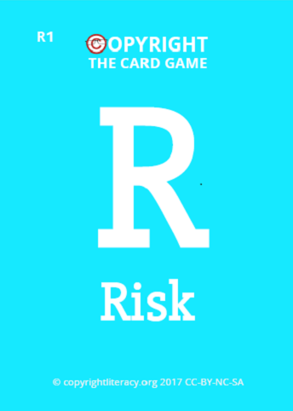


Copyright The card Game:
Works, usages, licences and exceptions
by Chris Morrison and Jane Secker
https://copyrightliteracy.org @UKCopyrightLit
Notes:
Find properly coloured icons

Slide 2
Running the card Game
1. It is licensed for non-commercial use only
2. You will need to be familiar with copyright to deal with queries and questions
3. You can train from 6 - 40 people
4. Allow 1.5 - 3 hours
5. Room set up – cabaret style
6. Customise the scenarios for your own context
7. Keep the pace up and have fun
Notes:
This is guidance for trainers – remove this slide before playing.

Slide 3
Overview
Time | Activity
15 minutes | Welcome, introductions and warm up quiz
20 minutes | Round 1 - Works
20 minutes | Round 2 - Usages
20 minutes | Round 3 - Licences
15 minutes | Tea / coffee
45 minutes | Round 4 – Works, Usages, Licences, Exceptions & Risk
15 minutes | Wrap up

Slide 4

Introductions
Introduce yourself to your team mates
Decide on your team name
Give us your team name for the score sheet
Notes:
Add our colours

Slide 5

Copyright Quiz
Q. What is the legislation?
A. Copyright, designs and patents act 1988, as amended and revised

Slide 6
Copyright Quiz
Q. What does copyright provide creators with?
A. Copyright gives certain exclusive rights to the owner of a work to incentivise and reward creativity

Slide 7
Copyright Quiz
Q. Does copyright protect ideas?
A. No, copyright does not protect ideas but the way they are expressed.

Slide 8
Copyright Quiz
Q. What tests must a copyright work pass?
A. For copyright to be subsist in a work it must be ‘original’ and be recorded or ‘fixed’.

Slide 9
Copyright Quiz
Q. What sort of content does copyright protect?
A. Copyright covers all different types of content (text, images, sound, moving images etc.)

Slide 10
Copyright Quiz
Q. Do copyright works need to be registered?
A. No, copyright protection is automatic as soon as the work is ‘fixed’.

Slide 11
Copyright Quiz
Q. Do works need a “©” in the UK to be protected?
A. No, copyright works don’t need a “©” in the UK to be protected, but it helps indicate that the works is protected.

Slide 12
Copyright: the game
Notes:
Cover over the card numbers

Slide 13
The rules
Each round will focus on one ‘suit’
Each team will have one deck of cards
Each team must nominate a card handler
Answers to the scenarios are given by selecting the cards
Teams should confer and agree answers

Slide 14
Works

Slide 15
Why consider types of
Copyright work?
W
Works
Different durations
Different layers of rights
Different owners within content
Different licences
Some exceptions work specific

Slide 16







Copyright works (1)
W
Works
Literary
Artistic
Musical
Dramatic
Broadcast
Sound Recording
Film

Slide 17






Copyright works (2)
W
Works
Typography
Public Domain
Database
Moral Rights
Performance
Non Qualifying
Work related
Notes:
Public domain = copyright has expired

Slide 18
round 1
W
Works
Use your “Works” cards to identify what types of works are in the object your team has been given
Notes:
Objects can include: DVDs, musical birthday cards, books (in and out of copyright), CDs, Software etc.
Each team is given a different item.

Slide 19
Usages

Slide 20
Why consider types of
Copyright usage?
U
Usages
They are the CDPA ‘restricted acts’ as defined in law
The ‘restricted acts’ must be ‘mapped’ onto any activity to understand licences and exceptions available

Slide 21

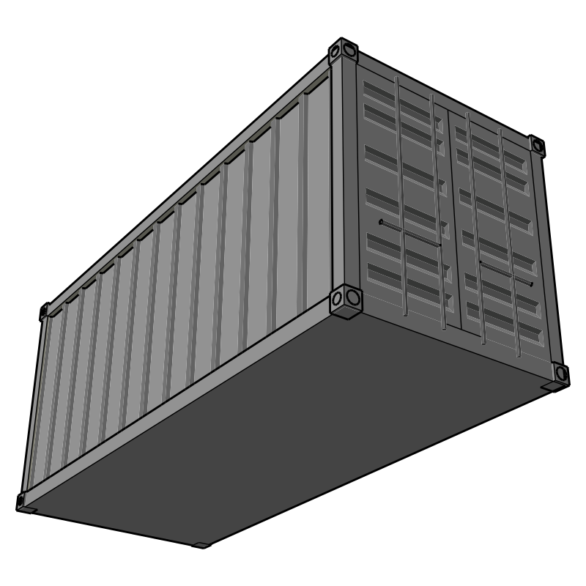



Copyright usages
U
Usages
Copying
Issuing copies to the public
Rental or Lending
Public Performance
Communication to the public
Adaptation

Slide 22
round 2
U
Usages
Using your “Usage” cards, decide what types of usage apply in the following scenario.

Slide 23

round 2
U
Usages
What types of usages apply?
1. A public library stages a production of Harry Potter and the Cursed Child
Public Performance
Copying?
Notes:
Arguably they might need to make copies of the script hence copying

Slide 24

round 2
U
U
Usages
What types of usages apply?
2. A café owner turns on a radio for her customers
FOR RENT
Communication to the public
Public Performance

Slide 25
round 2
U
Usages
What types of usages apply?
3. A writer creates short stories based on characters from the BBC TV programme, Eastenders
FOR RENT
Adaptation

Slide 26
round 2
U
Usages
What types of usages apply?
4. A blogger uploads a picture to his blog
FOR RENT
Copying
Communication to the public

Slide 27
Licences

Slide 28
Why consider types of
Copyright licence?
First point of call
  Can effectively provide zero risk
  May already have paid for them
They all involve limitations
  Not carte blanche
  Relationship with exceptions

Slide 29



Copyright licences (1)
L
Licences
Copyright Licensing Agency
CLA (Copyright Licensing Agency)
NLA Media Access
ERA (Educational Recording Agency)
Filmbank / MPLC
Library E-resources
Creative Commons
Newspaper Licensing Agency
Educational Recording Agency

Slide 30




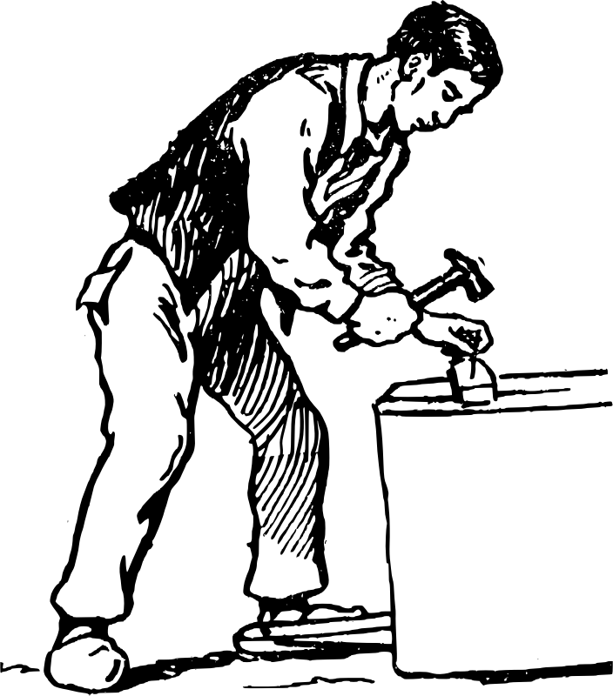

Copyright licences (2)
L
Licences
‘Bespoke’ permission
Website Terms & Conditions
UK Orphan Works Licence
You own the copyright
You made it as an employee
Licence related

Slide 31
round 3
L
Licences
Using your “Licences” cards, decide what types of licences apply in the following scenarios?

Slide 32
round 3
L
Licences
What types of licence might apply?
1. A librarian digitises a collection of unpublished annual reports made by a now defunct historical society from the early 20th century.
Copyright Licensing Agency
Newspaper Licensing Agency
Educational Recording Agency
‘Bespoke’ permission?
UK Orphan Works Licence

Slide 33
The game: round 3
L
Licences
What types of licence might apply?
2. A librarian taking extracts of published literary works and uploading them onto a university VLE for the use of registered students
Copyright Licensing Agency
Newspaper Licensing Agency
Educational Recording Agency
Copyright Licensing Agency
CLA HE Licence
E-Resource Licence?
Newspaper Licensing Agency
NLA Licence?
CC or Open Licence?

Slide 34
Exceptions

Slide 35
disclaimer
The following slides are intended to give an overview of the key UK copyright exceptions for those in higher education institutions. They are not comprehensive, nor do they provide full details of the provisions within the relevant legislation (most notably Copyright, Designs and Patents Act 1988).
The slides are for information purposes only and do not constitute formal legal advice.
If you find anything in the slides which appears to be inaccurate of misleading please contact ukcopyrightlit@gmail.com

Slide 36

Fair dealing
Determines whether usage is lawful or infringing based on how a ‘fair minded and honest person’ would deal with the work.
Does using the work affect the market for the original work? Does it affect or substitute the normal exploitation of the work.
Is the amount of the work taken reasonable and appropriate? Was it necessary to use the amount?

Slide 37






Key Exceptions to Copyright 1
E
Exceptions
S29 – Research or Private Study
S29a – Text & Data Mining
S30 – Quotation
S30A – Caricature, Parody or Pastiche
S31 - Accessible Copying
S32 – Illustration for instruction
Notes:
Update the new exceptions

Slide 38






Key Exceptions to Copyright 2
E
Exceptions
S34 – Educational Performance
S35 – Recording of Broadcasts
S36 – Educational Copying of Published Extracts
S40B - Dedicated Terminals
S41 – Library to Library Copying
S42 – Library Preservation

Slide 39



Key Exceptions to Copyright 3
E
Exceptions
S42A – Library Copying for Users
S43 - Library copying of unpublished works
S44B - Orphan Works

Slide 40




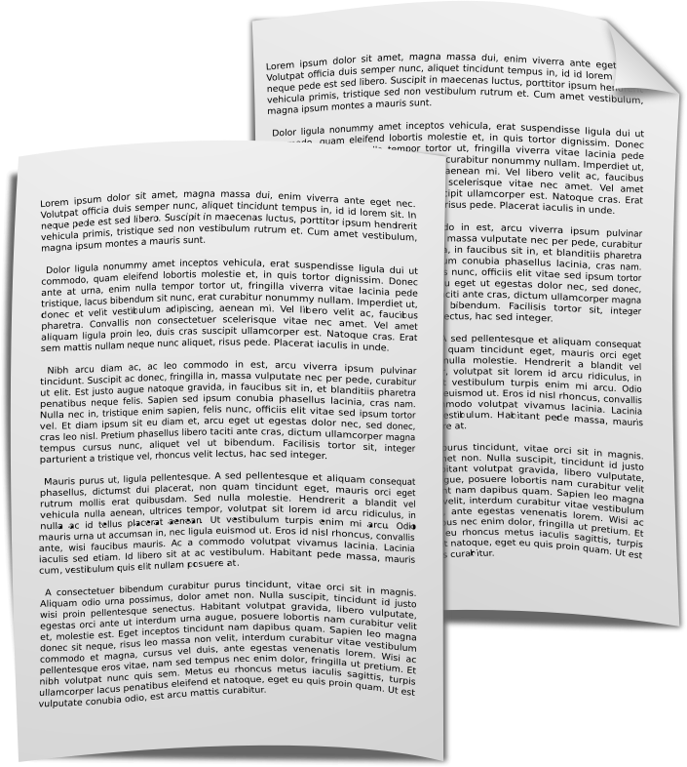




Copyright exceptions
Notes:
Out of all the copyright exceptions, perhaps the most important thing is that they are not subject to override by contract.

Slide 41
Non-contractual override
“To the extent that a term of a contract purports to prevent or restrict the doing of any act which, by virtue of this section, would not infringe copyright, that term is unenforceable.”
Copyright, Designs and Patents Acts 1988

Slide 42
round 4
The final round uses all the cards:

Slide 43
round 4
The Rules:
Consider the following scenarios within your teams
Play the relevant ‘Works’, ‘Usage’, ‘Licences’ and ‘Exceptions’ cards
Choose a level of risk from 0 to 5 and play the corresponding card

Slide 44
round 4
1. You are a lecturer at a university and you have identified a chapter in the book “A History of Greece” by Nicholas Doumanis (ISBN 9781137013675) that you want to include in your digital course reading pack. The course reading will be available on your institutional virtual learning environment (VLE). Your university library has the item in physical stock, but it is not available as an e-book.

Slide 45
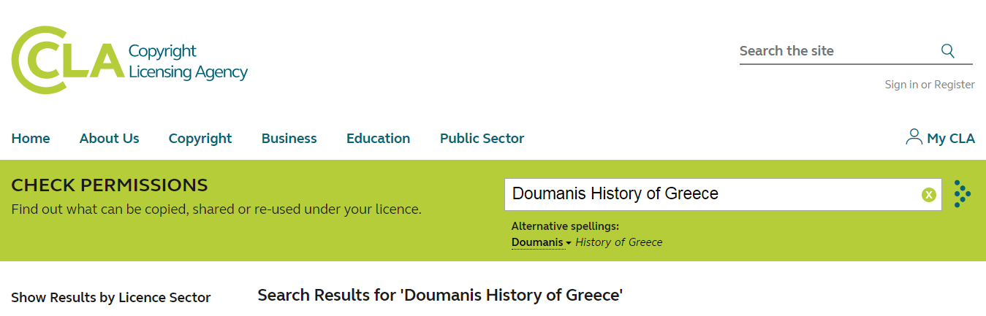
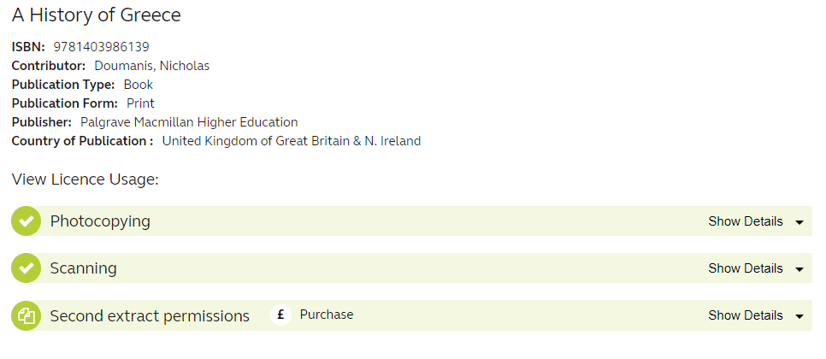

Slide 46





W
Works
U
Usages
1. Book Chapter
0
Risk
R
Risk
Copyright Licensing Agency
L
Licences
E
Exceptions

Slide 47
round 4
2. You want to create an online Open Educational Resource for students on architecture and decide to include a photo of a Frank Lloyd Wright (d.1959) building you find on a blog. The blogger has not identified who took the picture, or where it came from and attempts to make contact with them have resulted in no response. You decide to include the image anyway.

Slide 48


W
Works
U
Usages
2. Open Educational Resource
5
Risk
R
Risk
L
Licences
E
Exceptions

Slide 49
round 4
3. You are a lecturer in a university teaching students economics, exploring the causes of the financial crisis.
You find some charts and a useful infographic on the World Bank website. You wish to include these in your PowerPoint slides that you will use in the lecture to explore some of the possible causes of the crisis and the impact it had in specific countries.

Slide 50



W
Works
U
Usages
3. Infographic in PowerPoint
1
Risk
R
Risk
?
T’s & C’s
Agree
Cancel
L
Licences
E
Exceptions
?

Slide 51
round 4
4. A blind student needs an accessible version of a 40 page pamphlet you hold in your collection. They want a version suitable for use with their screen reader software and have asked their ‘library buddy’ to make a digitised version for them. The pamphlet is not covered by the CLA Licence and is not available in digital form.

Slide 52

W
Works
U
Usages
3. Accessible Copying
2
Risk
R
Risk
L
Licences
E
Exceptions

Slide 53
Chris and jane’s 3 top tips
1. First start by considering the works and usages
2. Then consider licences and if there are none that apply, look at exceptions.
3. You will always need to make a risk assessment. If relying on exception consider what is ‘fair’.

Slide 54
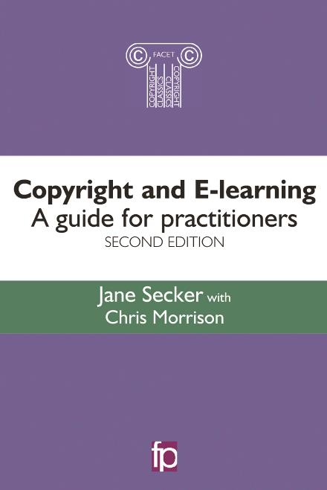
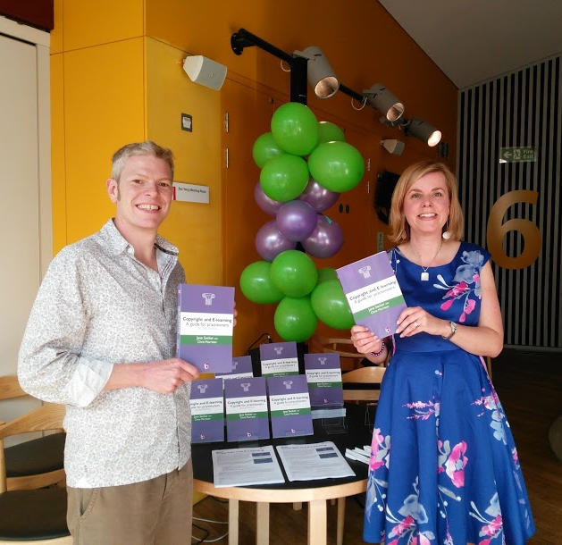

Further reading
@cbowiemorrison @jsecker
Chapter 6 available for free download (includes case study on the card game)
Notes:
Need to add ukcopyrightliteracy.wordpress.com

Slide 55
links
Copyrightliteracy.org
Copyright, Designs and Patents Act 1988
IPO Copyright Guidance
Jisc Copyright Guidance
Copyrightuser.org
Copyrightuser.org libraries guidance (Morrison & Secker)
Association of University Administrators guide to copyright (Morrison & Secker)
Notes:
Update links

Slide 56


Credits
These slides and accompanying cards are (apart from any images contained within) © Chris Morrison and Jane Secker (@UKCopyrightLit) 2017 and are available for reuse under a Creative Commons Attribution, Non-Commercial, Share Alike 4.0 licence.
UK Copyright Literacy:
http://copyrightliteracy.org
Clip Art icons are from openclipart.org

